Slide 1

P-REACT
Graphical User Interface
&
Cloud-side decision making

Slide 2
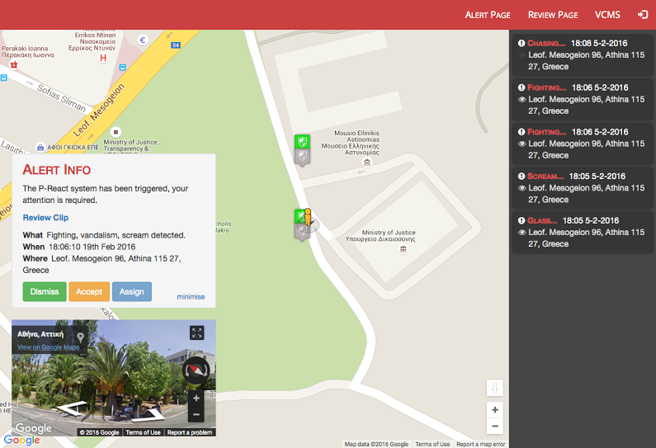
GUI – Alert Page

Slide 3
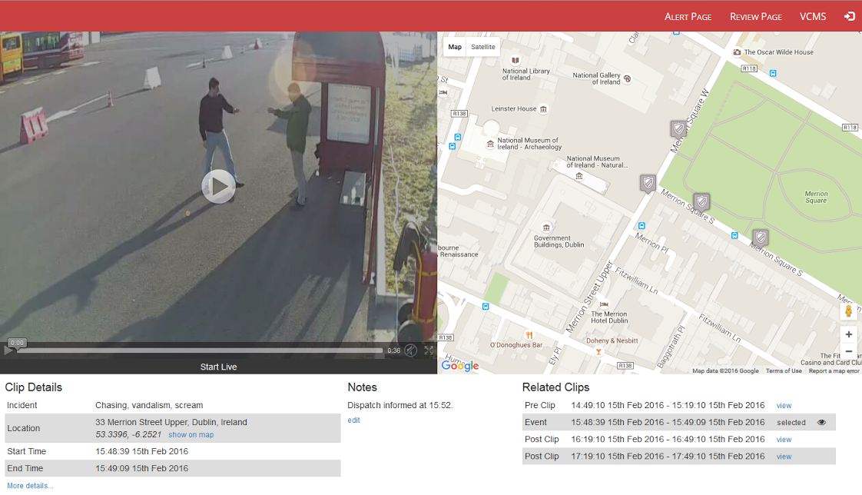
GUI – Review Page

Slide 4
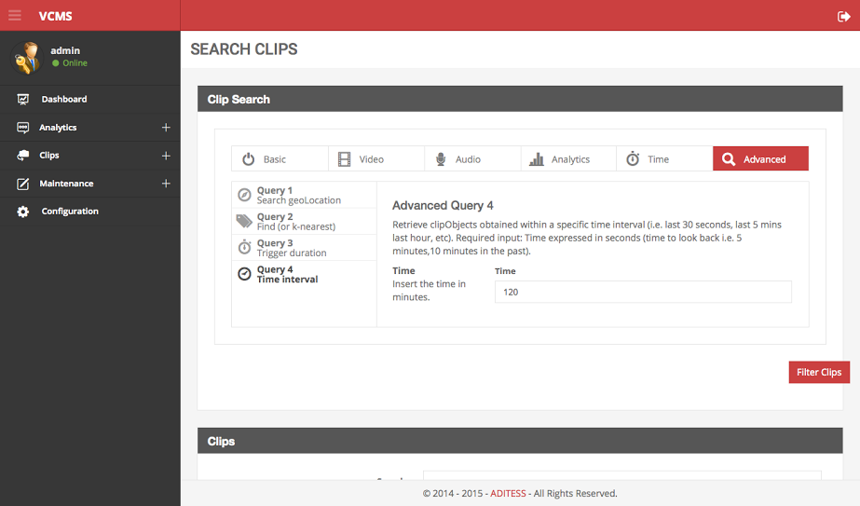
VCMS - Advanced Search

Slide 5
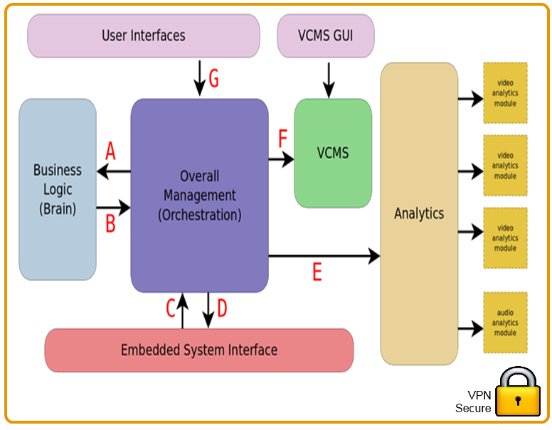
Cloud Operation

Slide 6

Rules and Data Flow
Scenario 1 – Rule Says Alert User
Brain Rule
Test
Action
Alert
User
Scenario 2 – Rule Says More Analysis Needed
Brain Rule
Test
Action
More Analysis

Slide 7
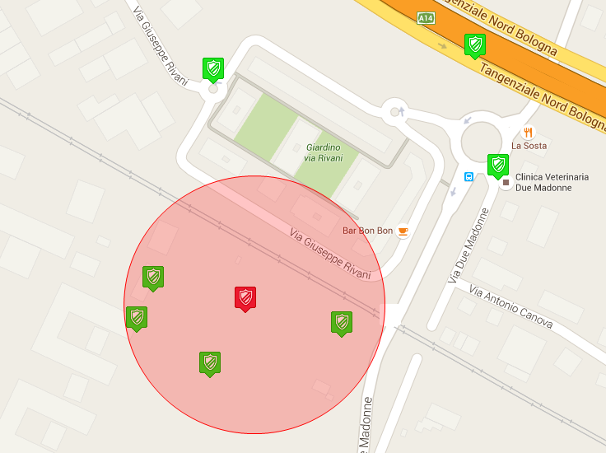
Situational Awareness
Scenario 3 – Rule Says Activate Nearby Cameras
Brain Rule
Test
Action
Activate
Neighbour

Slide 8
Thank you for your attention!
More info at:
Website: http://p-react.eu/
E-mail: contact@p-react.eu
LinkedIn: www.linkedin.com/groups?gid=8175906

