Slide 1

P-REACT
Embedded & Cloud
Platforms

Slide 2
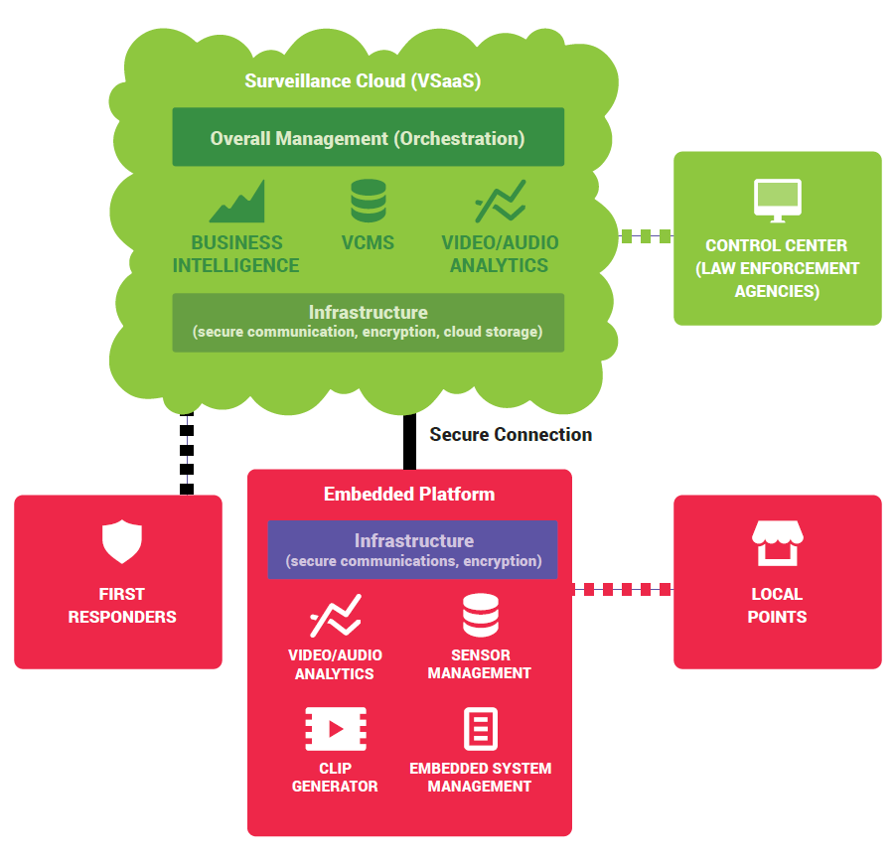
Embedded System
Easy to install and use.
Adaptable to the network conditions.
Supports a multitude of video/audio formats and codecs.
Real time reconfiguration of the system's components.
Supports standalone operation when connection with the cloud is not an option.

Slide 3
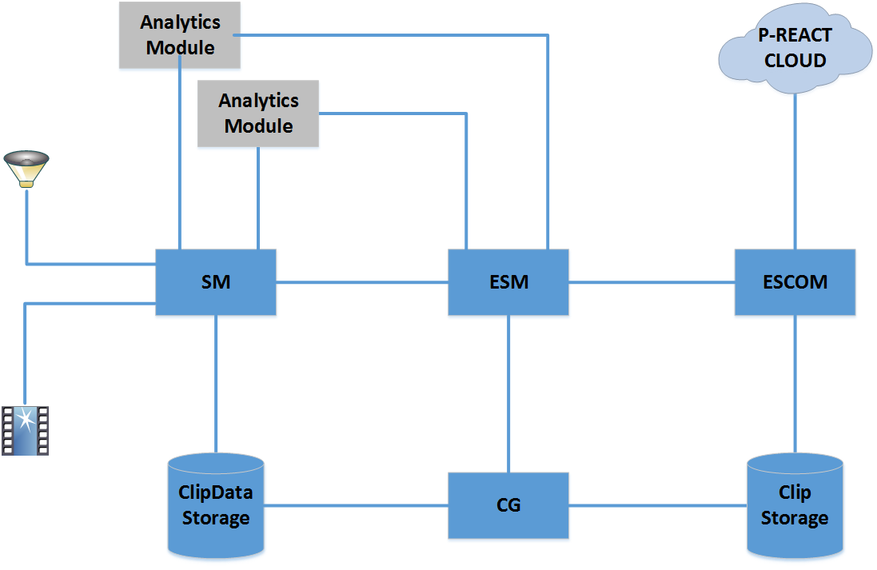
Embedded System
(Architecture & Modules)
ESM: Embedded System Manager, controls and coordinates the other ES modules. Handles the communication with Cloud.
ESCOM: Embedded System Communicator, uploads Clips to the cloud, initiates VPN connection, encrypts Clips (optionally).
CG: Clip Generator, encapsulates Clip Data,Clip metadata (Clip Object) and ES Analytics Results in one Clip.
SM: Sensors Manager, acquires Sensors' data and feeds them to the Analytics, besides clipping them exploiting one of the available encoding schemes. It supports real time streaming upon request.

Slide 4
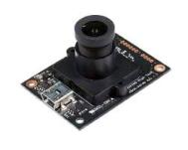
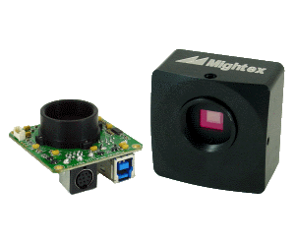
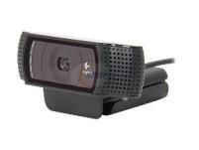
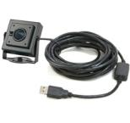
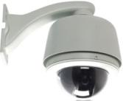
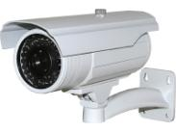


Embedded System (Sensors)
Embedded cameras
support
Various types of sensors supported
Enhanced Interoperability
USB cameras support
IP cameras support
USB, IP microphones
support

Slide 5
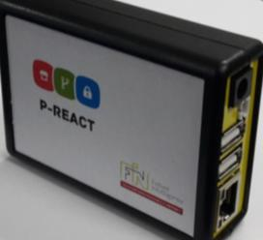
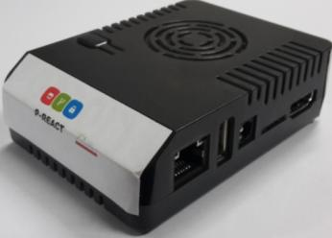

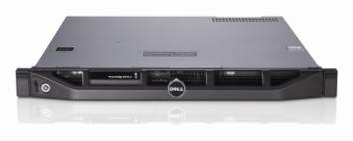
Embedded System
(Different Systems)
Actual P-REACT ES
Small scale areas
Supports various scales of deployment - using the same modules on different HW.
Modular design
Corporate large scale areas

Slide 6

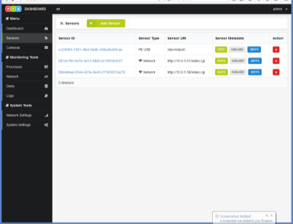
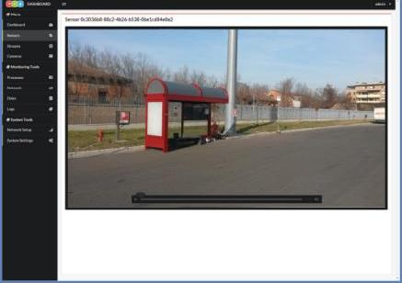
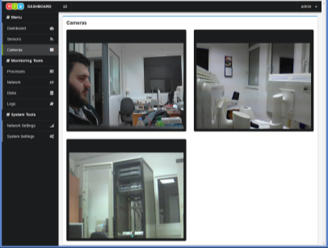
Embedded System (Management User Interface)
Easy set up with web interface
Secure access
Set cameras location
Grid view of cameras
Resources view
Beyond current CCTV systems
Etc.

Slide 7
Cloud System
Controlled and secured access
Abundance of Computational and Storage resources
Automated recovery and back up system
Support of flexible billing models
Computing Elasticity
Supports private installation for large scale environments

Slide 8
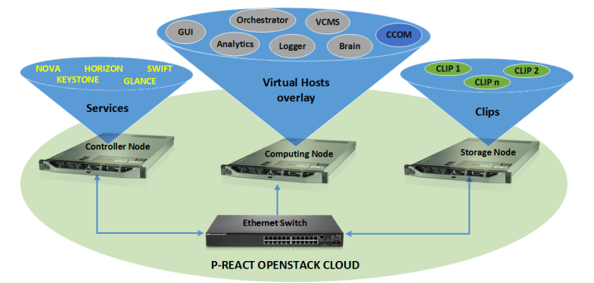
Cloud System
(Architecture & Modules)
CCOM: Cloud Communicator, receives the Clips from the Embedded Systems, de-encapsulates them, forwards the contained Clip Object to the Orchestrator and stores the contained Clip Data to the Cloud Storage. Handles VPN connections, de-encrypts Clips (optionally).
SWIFT: Object Storage Service (Clip Data storage)
KEYSTONE: Authentication Service
GLANCE: Imaging Service
NOVA: Computing Service
HORIZON: Dashboard service

Slide 9
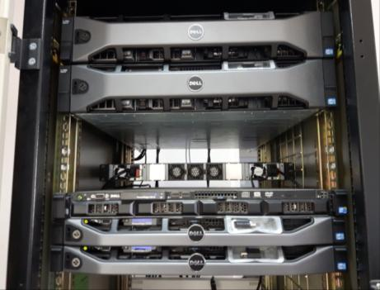
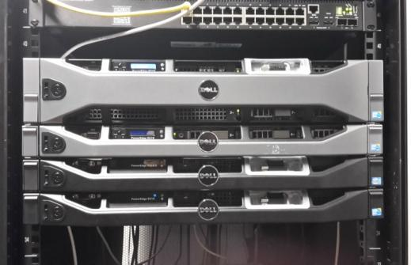
Cloud System (Infrastructure)
P-REACT Cloud Infrastructure
5 Servers, 2 Network Switches, Storage, Firewall
High-End HW
High Availability
P-REACT Backup Cloud Infrastructure
4 Servers, 2 Network Switches, Storage, Firewall

Slide 10
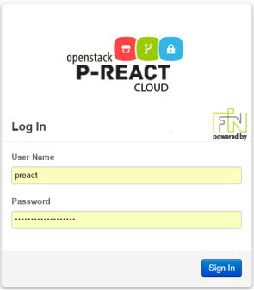
Cloud System
(Management Dashboard)
Easy set up with web interface
Update and install new images
Resources view
Manage Storage, Network, Computation

Slide 11

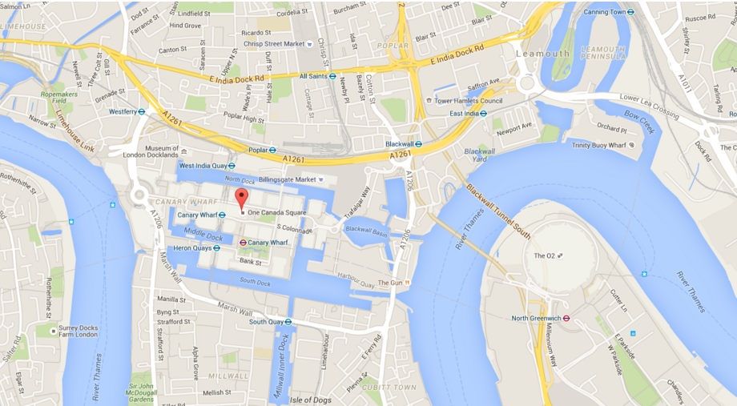

Thank you for your Attention
P-REACT team:
Nikos Zotos (CIO, Telecom Engineer)
George Bogdos (CTO, Telecom Engineer)
Anargyros Sideris (Senior Researcher, Systems & Software Engineer)
George Alexiou (Researcher, Software Engineer)

