Slide 1

P-REACT
Audio Analytics
& Content Management (VCMS)

Slide 2
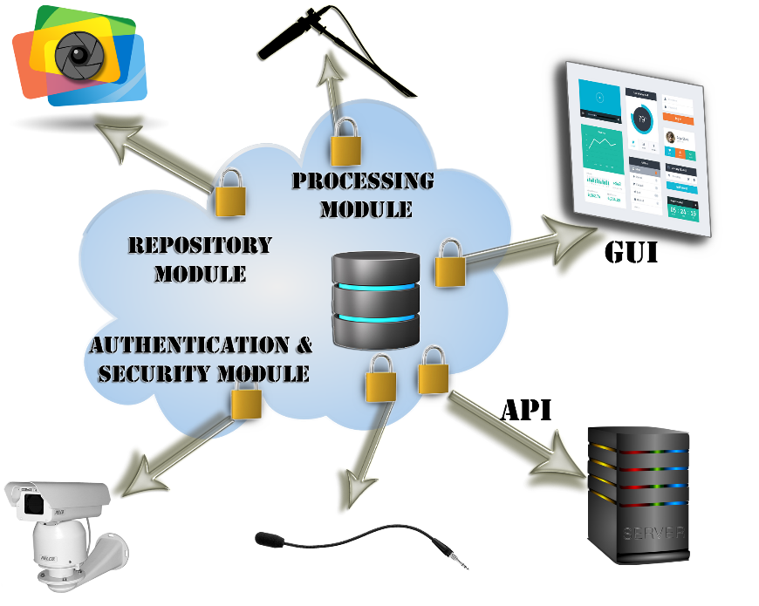
A Use Case
  Event takes place on a region under P-REACT surveillance; the audio and/or video monitoring modules are triggered
  Metadata for each file are generated according to its attributes.
  The multimedia content is sent to the P-React cloud infrastructure for event validation while nearby cameras are activated
  Once validated, an alert is clearly displayed
  on the P-REACT GUI and also forwarded to VCMS
  as a verified event
Authenticated users may access the system through:
  The GUI
  Initiating callbacks to API
Time tracking metadata are also automatically
generated allowing the system to erase content that
should not be retained any longer.

Slide 3
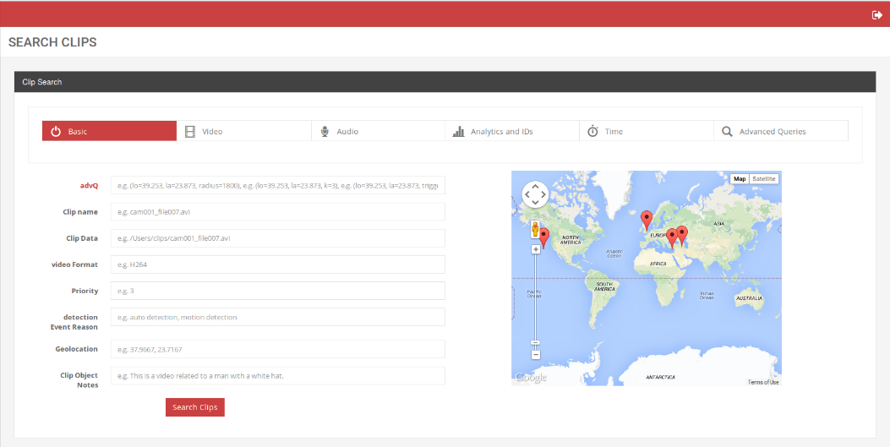
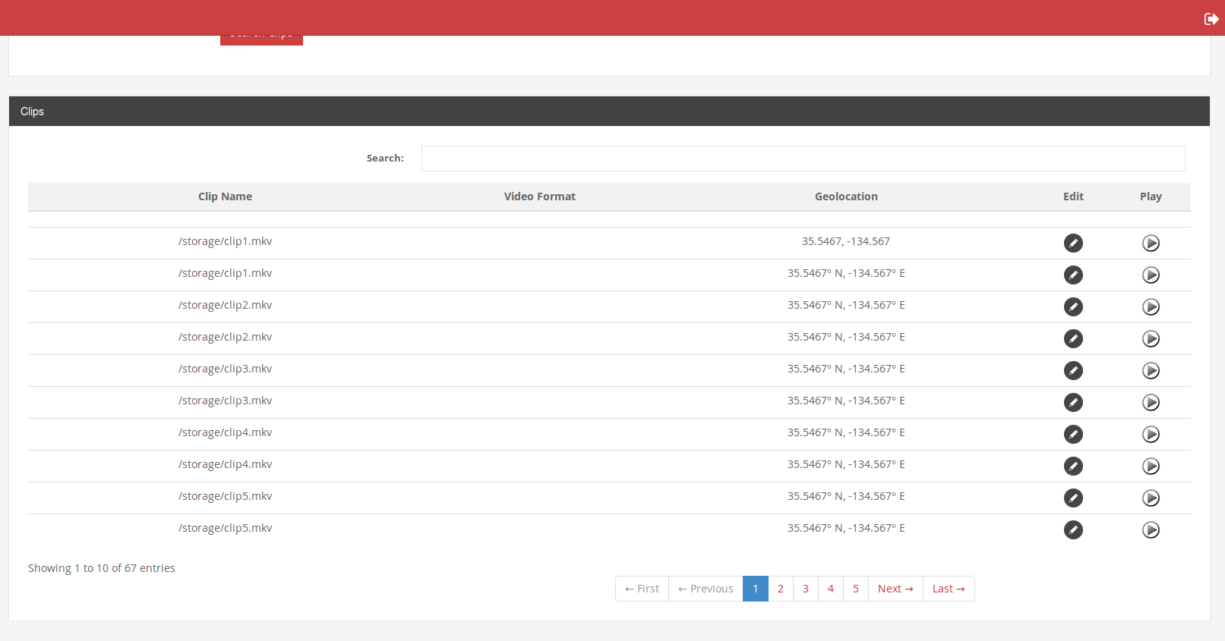
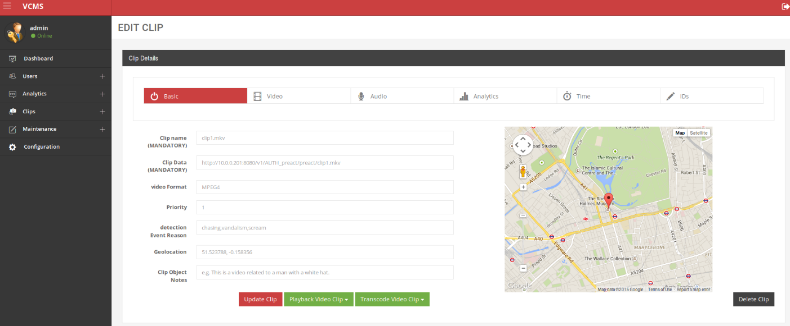
VCMS GUI

Slide 4
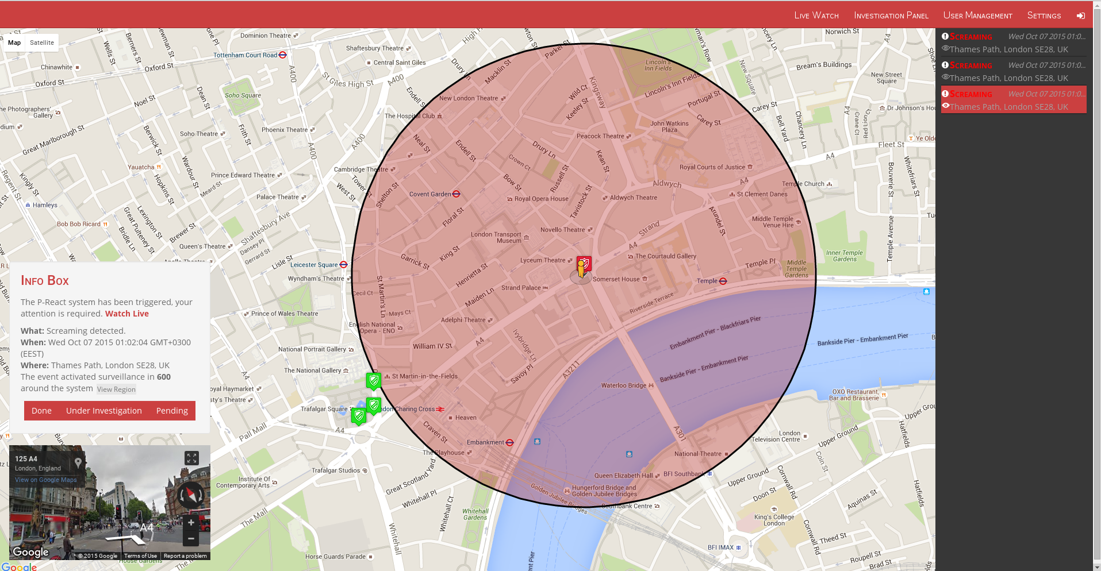
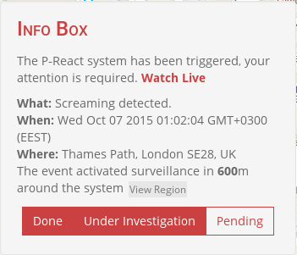
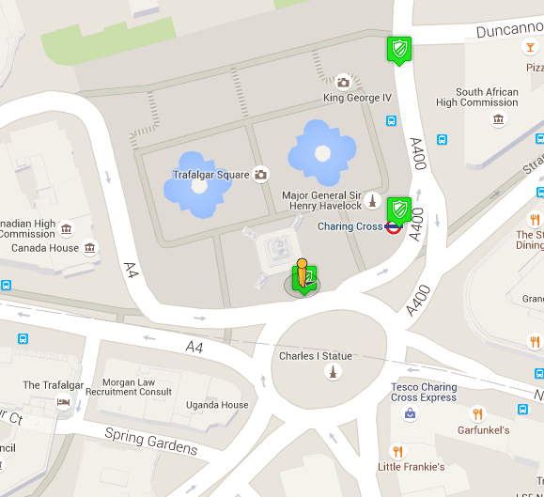

Slide 5
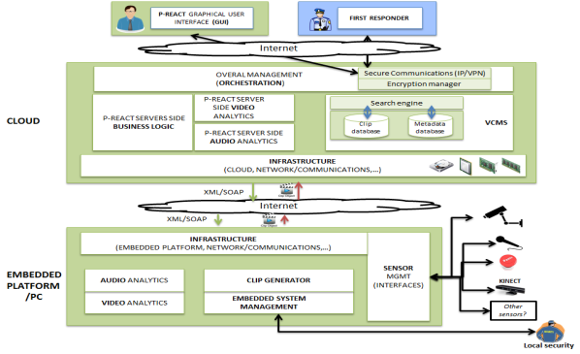
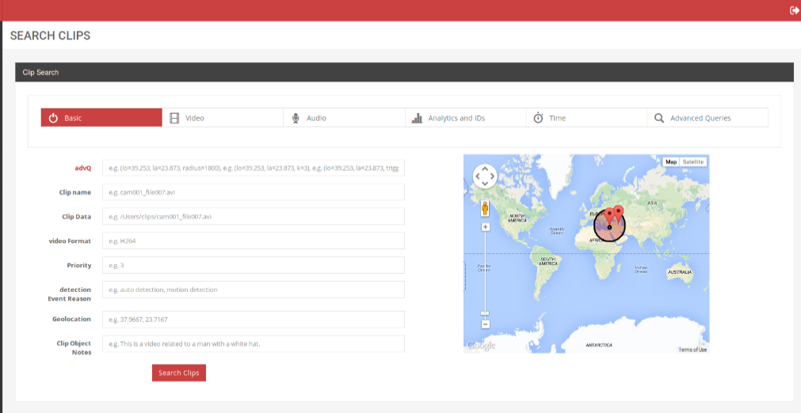
More Operational aspects
User Privileges: supports different levels of authentication
  Basic: view content
  Intermediate: view, update, download content, access to users’ repository
  Tech Admin: manages all technical aspects, no access to actual content
  Administrator: manages both technical and data aspects
Advanced Queries
  Proximity searches
  Integrated maps
  Calculates duration of incident
  Provides field-related information

Slide 6
Motivation: Audio Surveillance
“Audio covers a 360° area day and night, at a low cost, and surpasses the limitation of the viewing of conventional surveillance cameras.”
“The lack of audio in surveillance systems impacts significantly the ability of security personnel to act timely, if at all, in cases of emergency”
The use of audio sensors in surveillance and monitoring applications has proved to be particularly useful for the detection of events like screaming and gunshots
Impose prohibitively growing expenses as the number of deployed sensors escalates
Solutions aim use in open and unrestricted environments, effective operation of the systems

Slide 7
Audio Analytics
Critical for the seamless triggering of a surveillance system. Manages the detection abnormal events:
Screaming , Gunshots, Glass Breaking
Event detection takes place on the embedded system, upon occurrence of an event the results are transferred on the cloud for further analysis
  Aims to limit the number of false positive and therefore allowing the system to operate without unwanted traffic in the form of metadata objects
Due to privacy reasons, the audio data is not retained
Analytics module on the embedded system solves the classification problem with a number of cascaded binary classification tree
On the cloud side a number of different analytics methods are available for analysis
  Offering more flexibility compared to the designed strategy on the ES

Slide 8
ES Classification Strategy
Analytics module on the embedded system solves the classification problem with a number of cascaded binary classification trees
Audio Analytics
Human
Screaming
Non-Screaming
Non-Human
Emergency Sound
Normal Sound

Slide 9
Cloud Side Analytics: Results
Parameterization
  C4.5 no pruning,
  k-NN with k=3,
  Random forests with tree bagging of 20
  SVM with the RBF kernel, max allowed iterations 15000 and a 5% level of violation of the KKT conditions
 | Glass Vs NonScreams |  |  |  | Gunshot Vs NonScreams |  |  |  | Screams Vs NonScreams
 | C4.5 | k-NN | RF | SVM | C4.5 | k-NN | RF | SVM | C4.5 | k-NN | RF | SVM
Accuracy | 1.00 | 1.00 | 1.00 | 0.81 | 0.99 | 0.98 | 0.99 | 0.97 | 1.00 | 1.00 | 1.00 | 0.99
Sensitivity | 1.00 | 1.00 | 1.00 | 0.78 | 0.99 | 0.99 | 0.99 | 0.97 | 1.00 | 1.00 | 1.00 | 0.99
Specificity | 0.99 | 1.00 | 1.00 | 1.00 | 0.86 | 0.93 | 0.96 | 0.99 | 0.97 | 0.98 | 0.99 | 1.00
Precision | 0.99 | 1.00 | 1.00 | 1.00 | 0.99 | 1.00 | 1.00 | 1.00 | 1.00 | 1.00 | 1.00 | 1.00
Recall | 1.00 | 1.00 | 1.00 | 0.78 | 0.99 | 0.99 | 0.99 | 0.97 | 1.00 | 1.00 | 1.00 | 0.99
F-Measure | 1.00 | 1.00 | 1.00 | 0.87 | 0.99 | 0.99 | 1.00 | 0.99 | 1.00 | 1.00 | 1.00 | 0.99
Gmean | 0.99 | 1.00 | 1.00 | 0.88 | 0.93 | 0.96 | 0.97 | 0.98 | 0.98 | 0.99 | 0.99 | 0.99
AUC | 1.00 | 1.00 | 1.00 | 0.71 | 0.93 | 0.86 | 0.94 | 0.75 | 0.98 | 0.92 | 0.99 | 0.70
Notes:
C4.5 no pruning means no tree cutting
Bagging means so many trees have been generated. A new sample is classified against those trees and a class is assigned to the sample based on the majority rule.

Slide 10
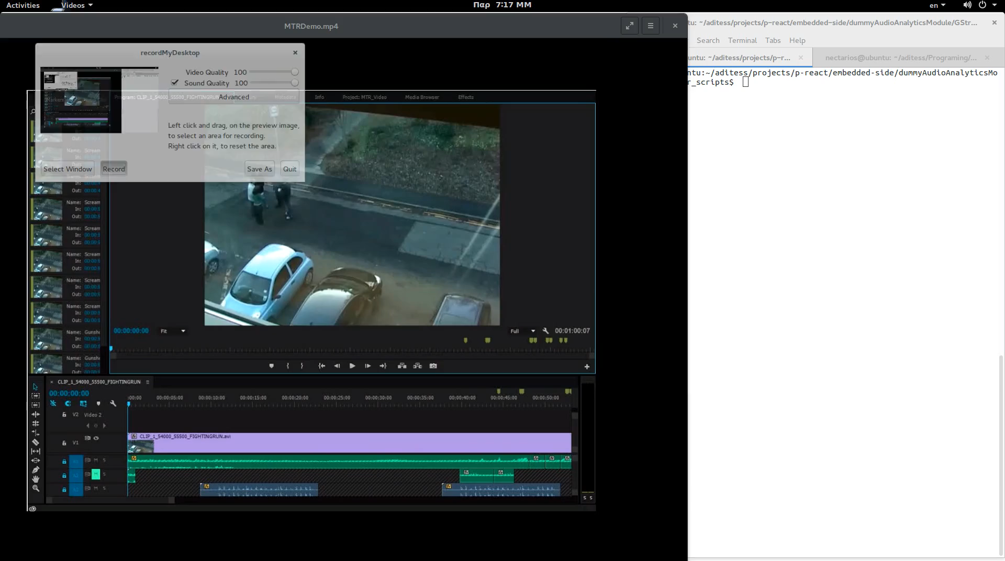
How does it look in practice?

Slide 11

Thank You!
Nikolaos Koutras
Managing Director
(Administration CP) management@aditess.com
Liza Charalambous
Researcher & Software Engineer
(Technical CP) lc@aditess.com

