Slide 1

P-REACT
Embedded & Cloud
Platforms

Slide 2
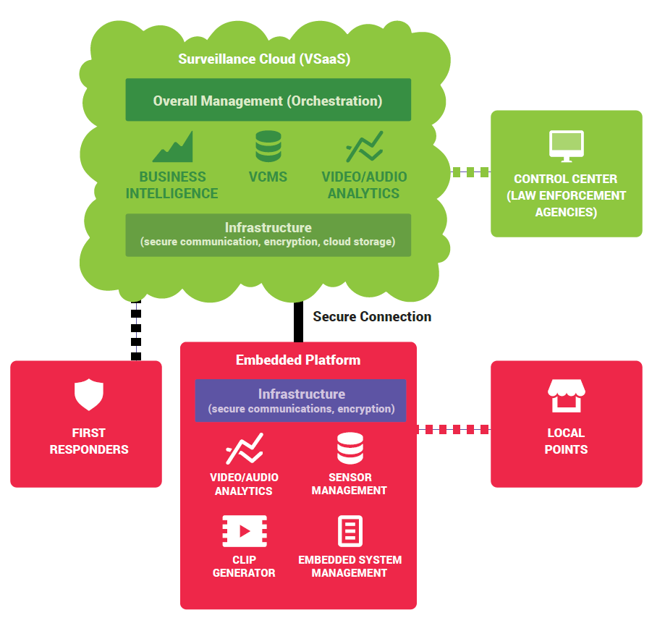
OVERALL ARCHITECTURE
Cloud orchestrated embedded systems
Multi-sensor support (currently video, depth, and audio)
Energy and storage efficient solution that adapts the “Clip” to the network conditions
Reduces search time on investigations
2 levels of analysis (embedded and cloud)
Operator can focus his/her attention on alerts
Easy to integrate with current surveillance systems
Dynamically configurable solution (by default business rules and/or on-the-fly changes made by the operator)
Access levels based on user profiles

Slide 3
Embedded System
Easy to install and use (normally less than an hour for a small shop/location/bus stop).
Adaptable to the network conditions.
Supports a multitude of video/audio formats and codecs (98 codecs; including all the most widely used ones).
Supports standalone operation when connection with the cloud is not an option.
Real time re-configuration of the system's components.
  A “Clip” is generated and sent to the cloud when an event is detected

Slide 4
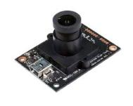
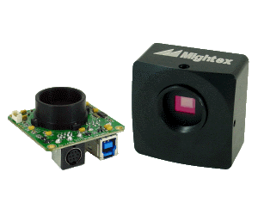
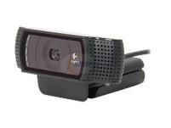
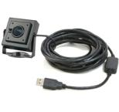
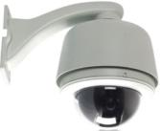
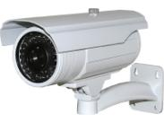
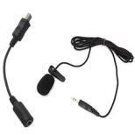
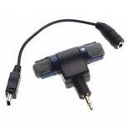
Embedded System (Sensors)
Embedded cameras
support
Various types of sensors supported
Enhanced Interoperability
Also support integration with legacy cameras
USB cameras support
IP cameras support
USB, IP microphones
support

Slide 5
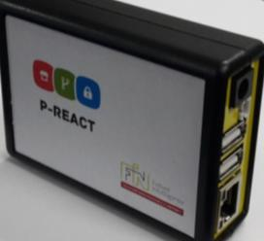
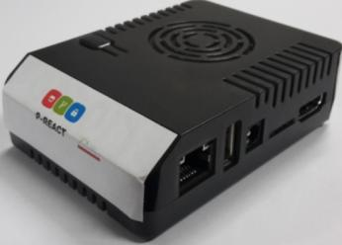

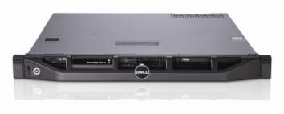
Embedded System
(Different Systems)
Actual P-REACT ES
Small scale areas
Supports various scales of deployment - using the same modules on different HW.
Modular design
Corporate large scale areas (above 50 sensors)

Slide 6
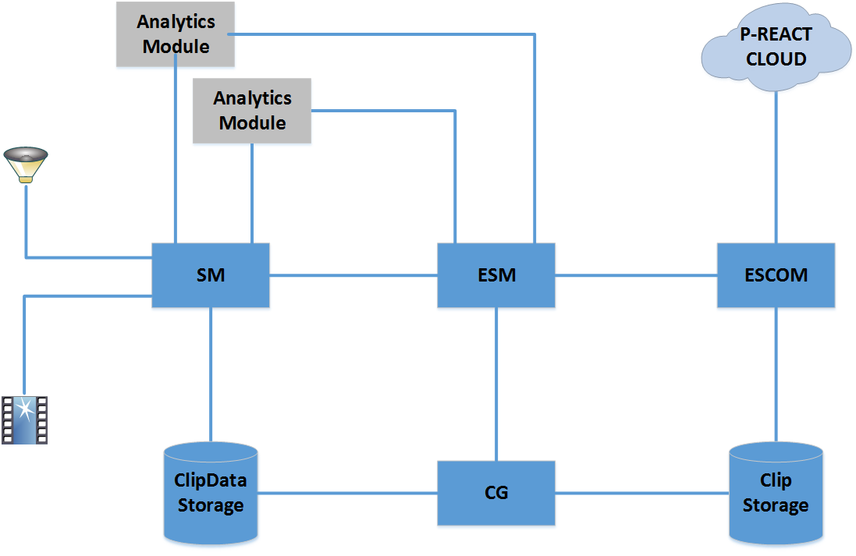
Embedded System how does it work?
ESM: Embedded System Manager, controls and coordinates the other ES modules. Handles the communication with Cloud.
ESCOM: Embedded System Communicator, uploads Clips to the cloud, initiates VPN connection, encrypts Clips (optionally).
CG: Clip Generator, encapsulates Clip Data,Clip metadata (Clip Object) and ES Analytics Results in one Clip.
SM: Sensors Manager, acquires Sensors' data and feeds them to the Analytics, besides clipping them exploiting one of the available encoding schemes. It supports real time streaming upon request.

Slide 7
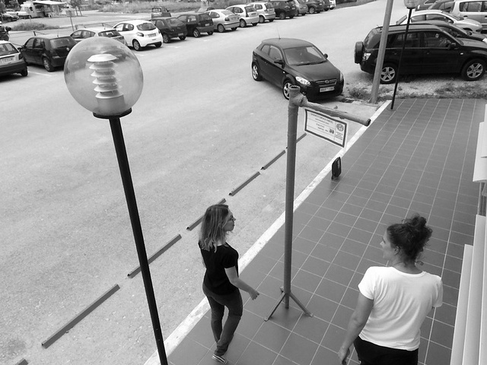
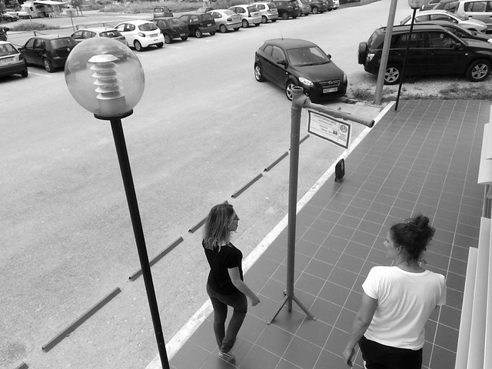

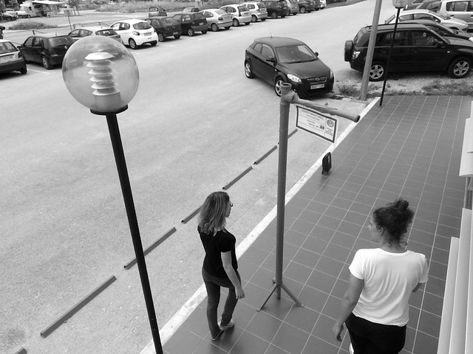
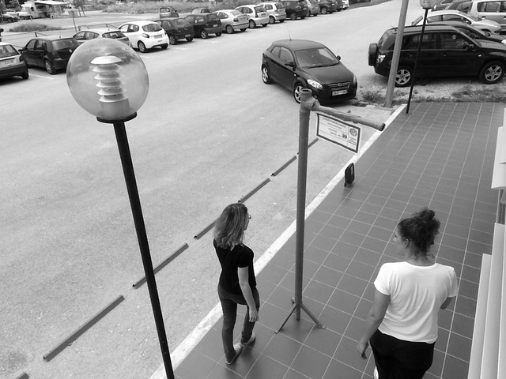
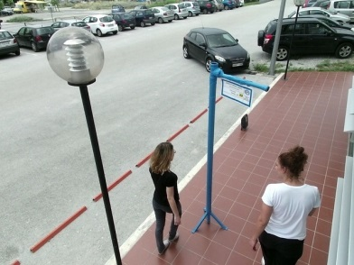
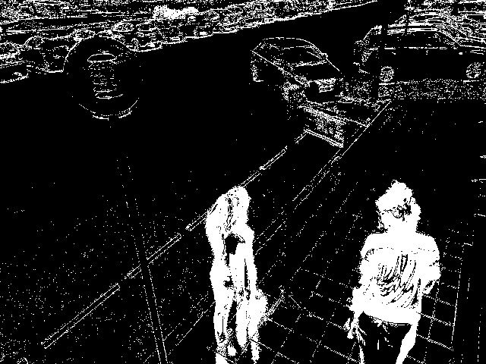
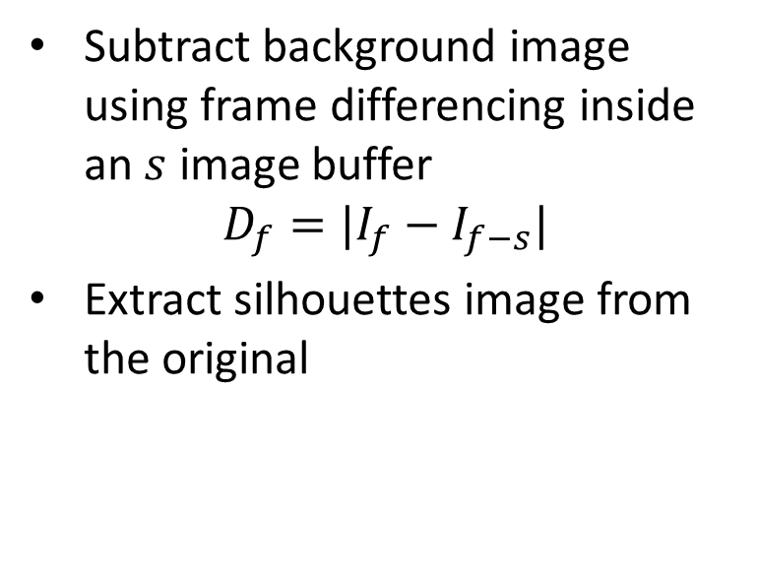
Sample video analysis run on the embedded platforms
Subtract background image using frame differencing inside an $s$ image buffer
$$D_{f}=|I_{f}−I_{f−s}|$$
Extract silhouettes image from the original
Original Image
Subtracted Frame

Slide 8
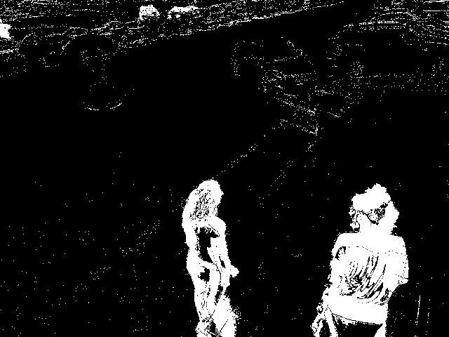
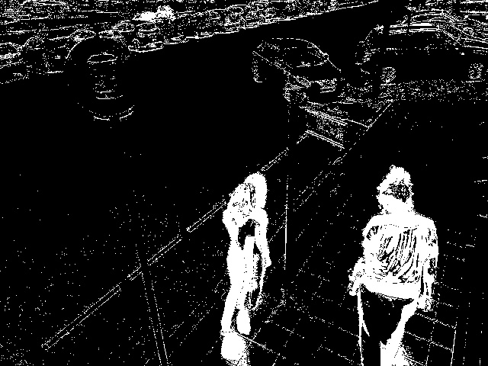

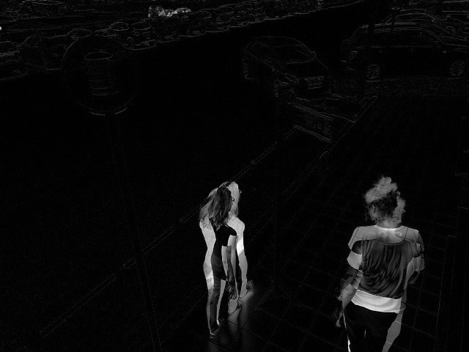
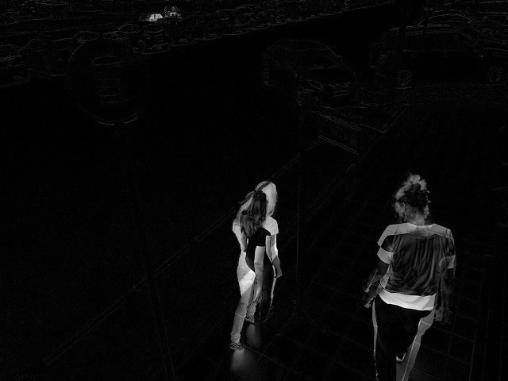


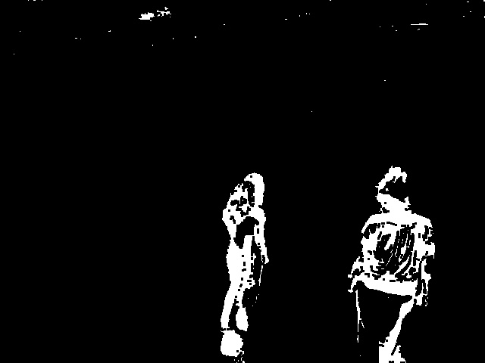
Sample video analysis run on the embedded platforms
Denoising Stages :
The Subtracted background image
Foreground Image thresholding
Applying Morphological filter (erosion)

Slide 9
Cloud System
Controlled and secured access (different access levels for different user profiles)
Abundance of Computational and Storage resources
Automated recovery and back up system
Support of flexible billing models
Computing Elasticity
Currently tested with OpenStack cloud framework (easy to migrate to other solutions)
Scalable solution (tested with 10 concurrent embedded platforms)
Supports private installation for large scale environments

Slide 10
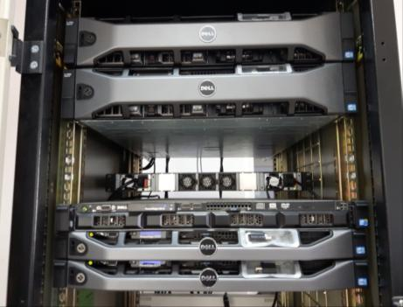
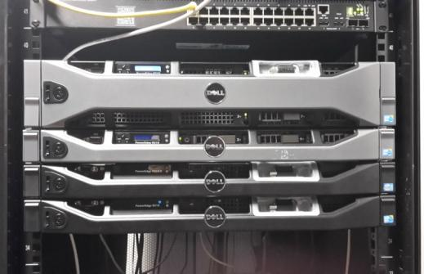
Cloud System (Infrastructure)
P-REACT Cloud Infrastructure
5 Servers, 2 Network Switches, Storage, Firewall
High-End HW
High Availability
P-REACT Backup Cloud Infrastructure
4 Servers, 2 Network Switches, Storage, Firewall

Slide 11
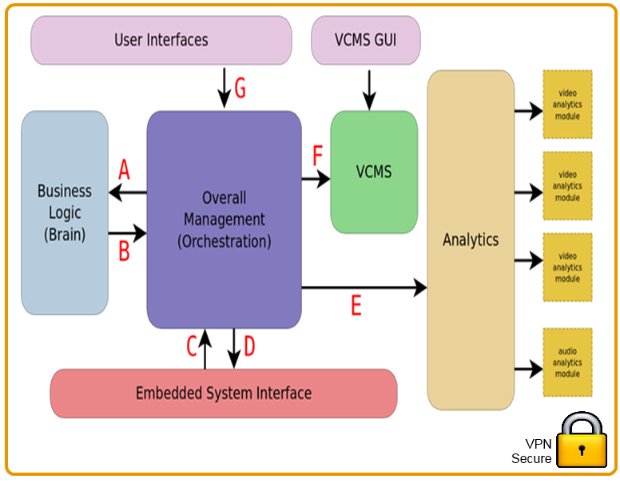
Cloud framework how does it work?

Slide 12
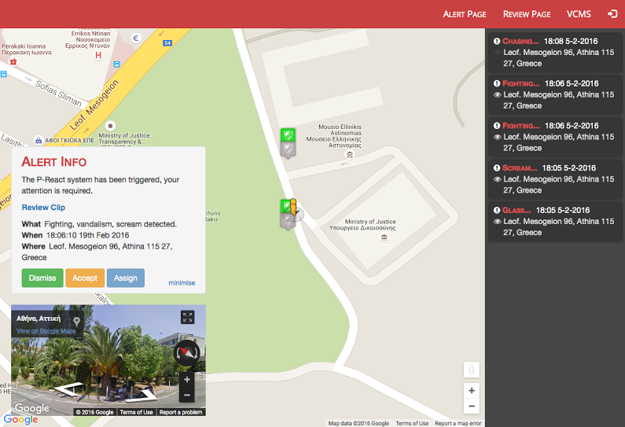
OPERATOR’S GUI – Alert Page

Slide 13
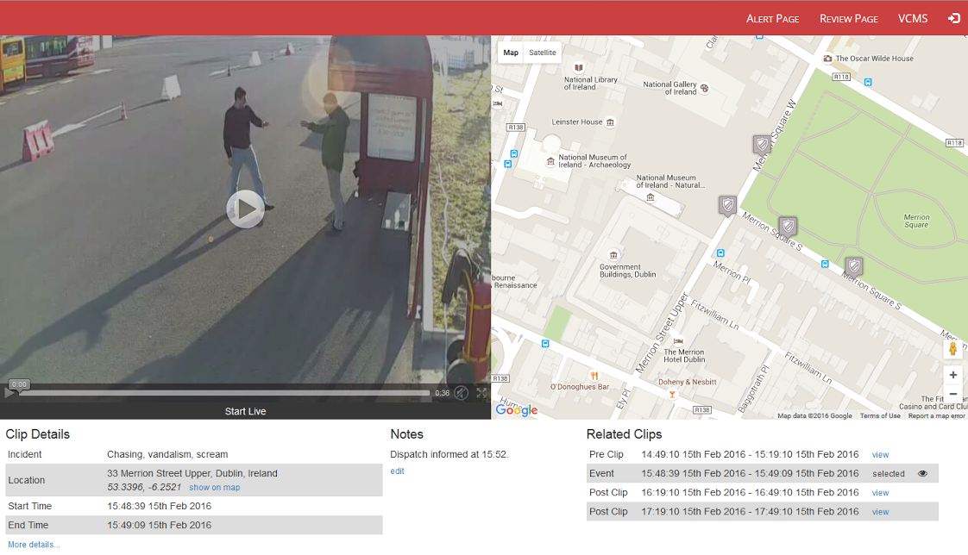
OPERATOR’S GUI – Review Page

Slide 14
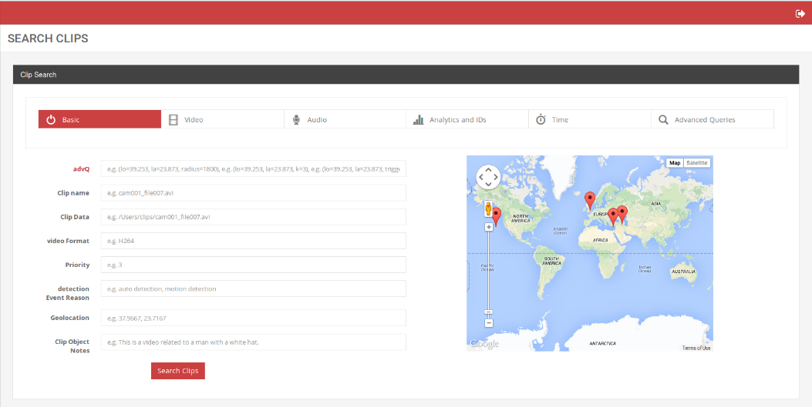
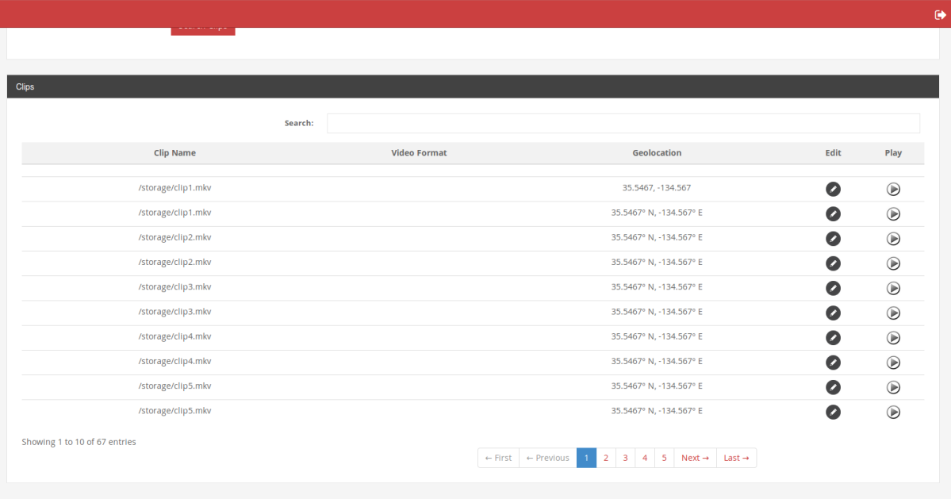
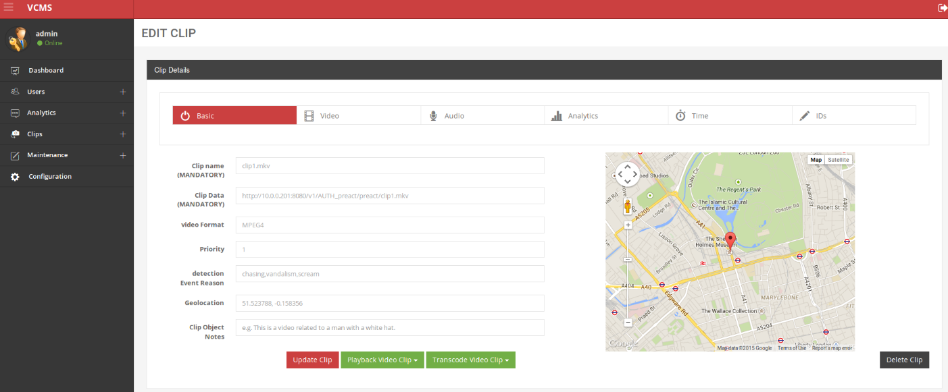
OPERATOR’S GUI - VCMS

Slide 15

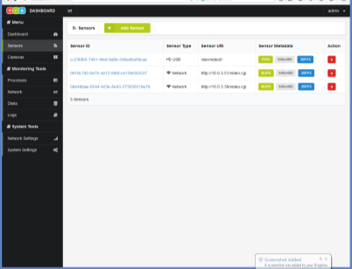
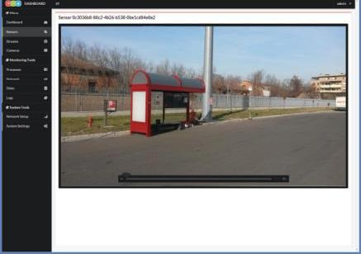
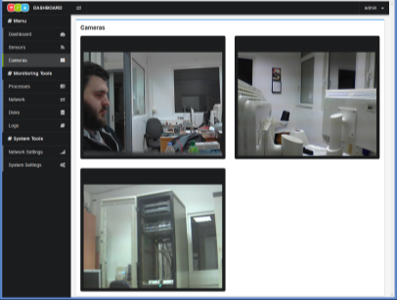
ADMIN GUI - Embedded System
Easy set up with web interface
Secure access
Set cameras location
Grid view of cameras
Resources view
Beyond current CCTV systems
Etc.

Slide 16
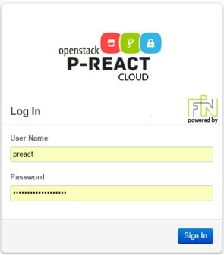
ADMIN GUI - Cloud System
Easy set up with web interface
Update and install new images
Resources view
Manage Storage, Network, Computation

Slide 17
BACKUP

Slide 18
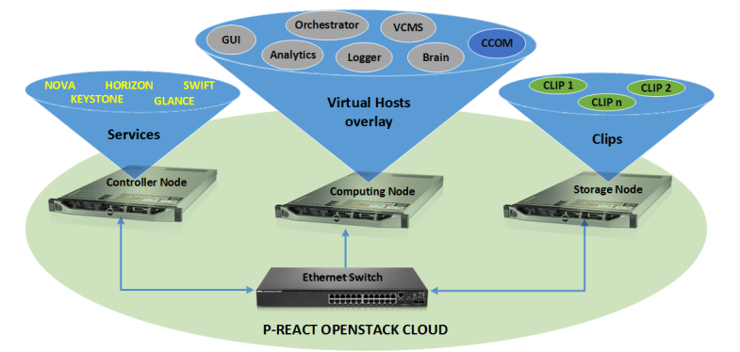
Cloud System
(Architecture & Modules)
CCOM: Cloud Communicator, receives the Clips from the Embedded Systems, de-encapsulates them, forwards the contained Clip Object to the Orchestrator and stores the contained Clip Data to the Cloud Storage. Handles VPN connections, de-encrypts Clips (optionally).
SWIFT: Object Storage Service (Clip Data storage)
KEYSTONE: Authentication Service
GLANCE: Imaging Service
NOVA: Computing Service
HORIZON: Dashboard service

Slide 19

Rules and Data Flow
Scenario 1 – Rule Says Alert User
Brain Rule
Test
Action
Alert
User
Scenario 2 – Rule Says More Analysis Needed
Brain Rule
Test
Action
More Analysis

Slide 20
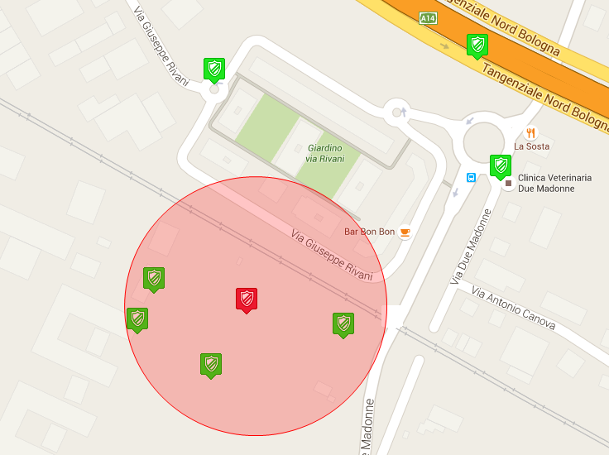
Situational Awareness
Scenario 3 – Rule Says Activate Nearby Cameras
Brain Rule
Test
Action
Activate
Neighbour

