Slide 1

P-REACT
Video Analytics

Slide 2
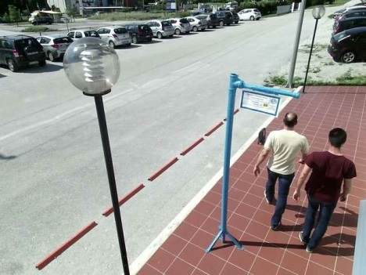
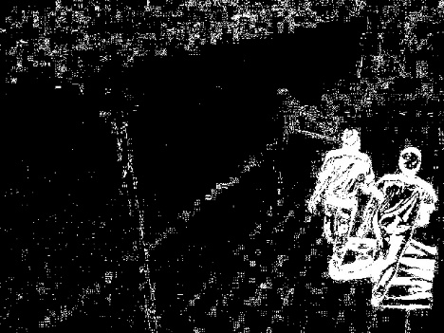
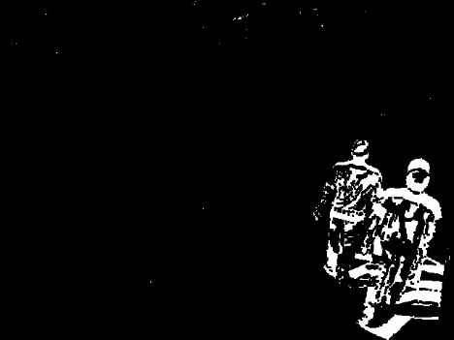
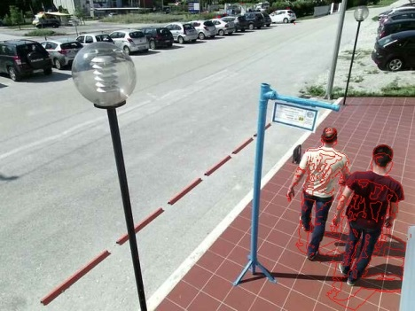
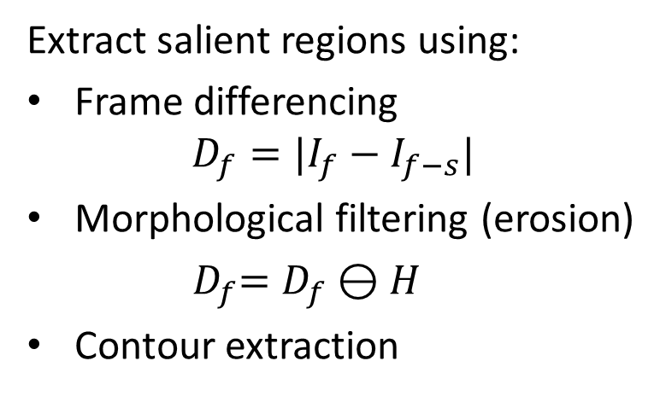
Video Analytics
Analytics using and RGB/IR sensor and an odroid-XU3 system.
Extract salient regions using:
Frame differencing
$$D_{f}=|I_{f}−I_{f−s}|$$
Morphological filtering (erosion)
${ D}_{f}=D_{f}⊖H$
Contour extraction
Accurately detect motion (also tested with IR and depth data)

Slide 3
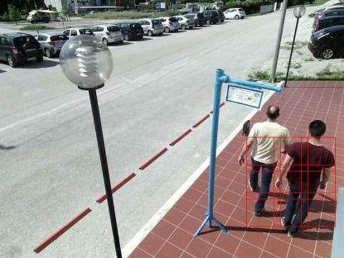
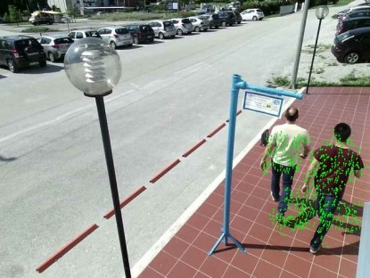
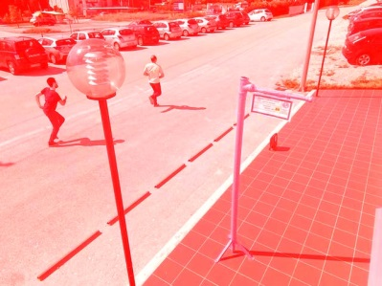
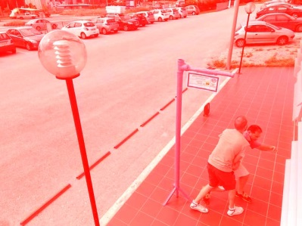
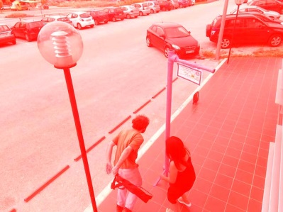
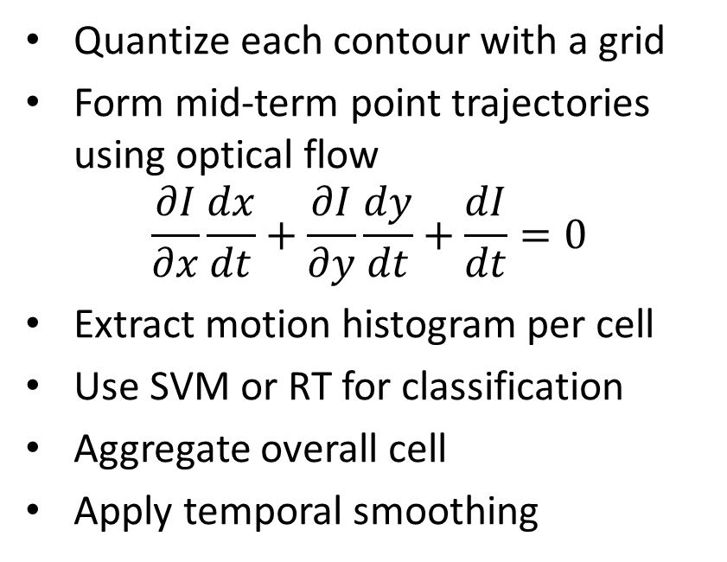
Video Analytics
Quantize each contour with a grid
Form mid-term point trajectories using optical flow
$$\frac{∂I}{∂x}\frac{dx}{dt}+\frac{∂I}{∂y}\frac{dy}{dt}+\frac{dI}{dt}=0$$
Extract motion histogram per cell
Use SVM or RT for classification
Aggregate overall cell
Apply temporal smoothing
Detect anomalous activity (running, fighting, bag snatching)

Slide 4
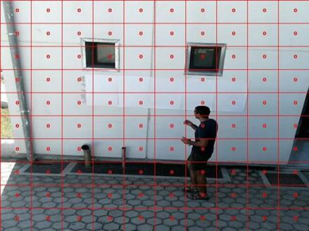
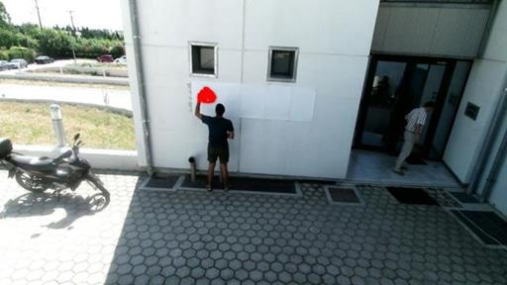
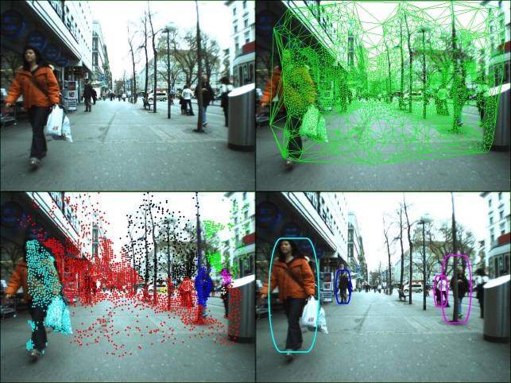
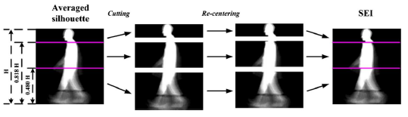
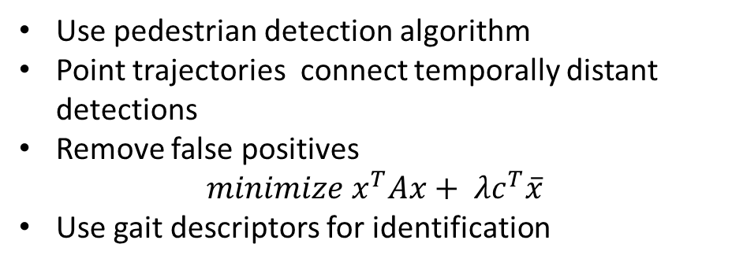
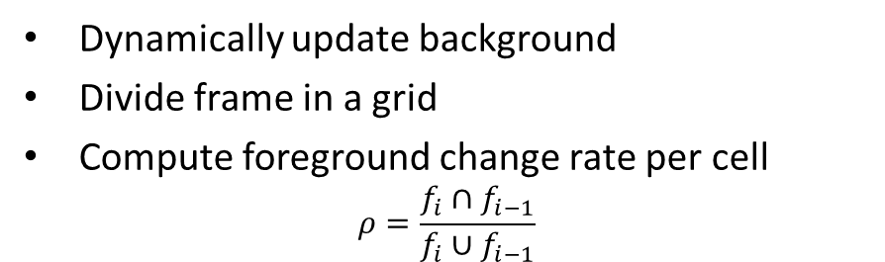
Video Analytics
Dynamically update background
Divide frame in a grid
Compute foreground change rate per cell
$$ρ=\frac{f_{i}∩f_{i−1}}{f_{i}∪f_{i−1}}$$
Detect static changes in the background (applied to graffiti detection)
Use pedestrian detection algorithm
Point trajectories connect temporally distant detections
Remove false positives
$$minimize x^{T}Ax+ λc^{T}\overline{x}$$
Use gait descriptors for identification
Multiple humans tracking and identification

Slide 5
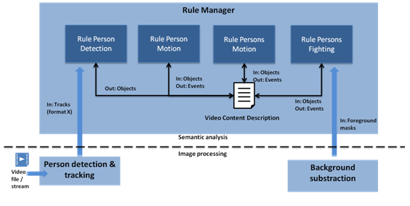
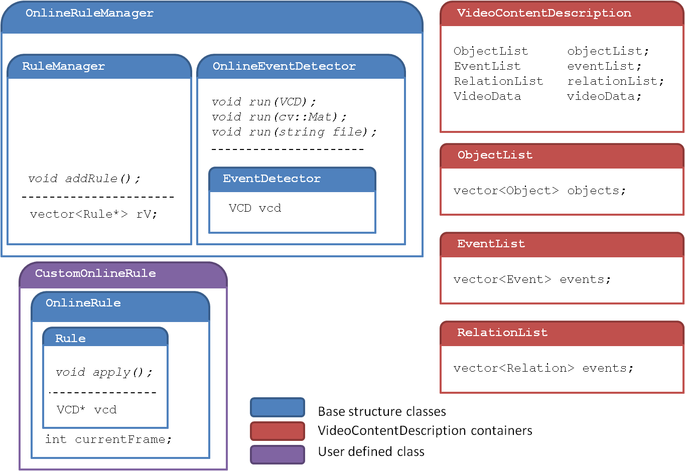
Video Analytics
Detection of events
  Rule Manager framework
  Higher abstraction layer
  From images to concepts
Video Content Desctription
  Interconnected Semantic elements: “Objects”, “Events”, and “Relations”
  C++ architecture, XML persistence
  Online and offline processing (for embedded-side and cloud-side analytics)

Slide 6
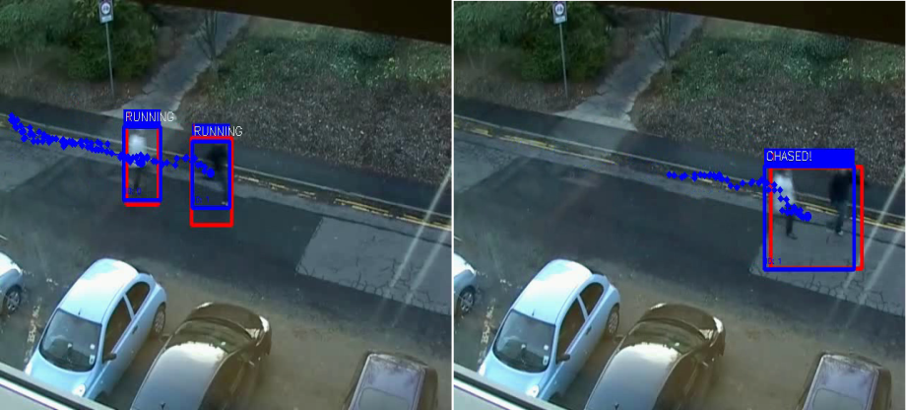

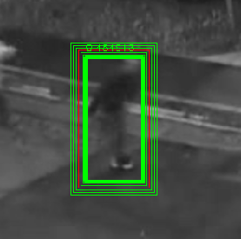
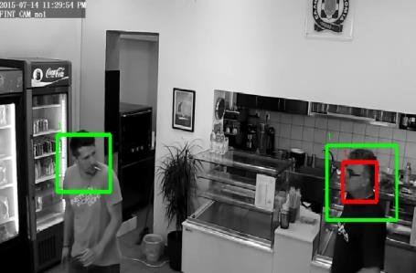
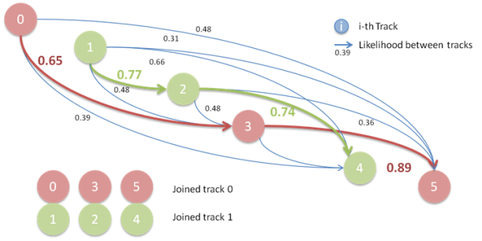
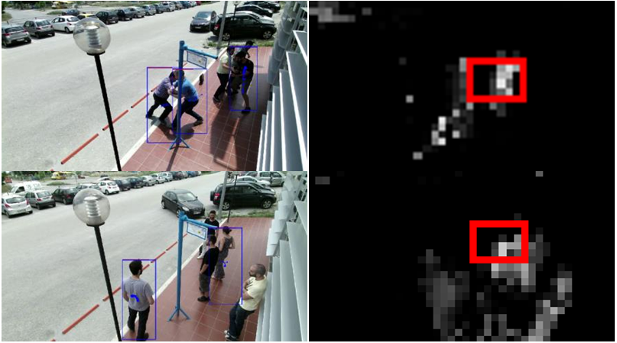
Video Analytics
Detection and tracking of individuals
  Close, mid and far-distance views
  Different profiles
  Track joiner for enhanced reliability
Detection of events
  “Motion”, “Running”, “Chasing”, “Fighting”, “Group”

Slide 7
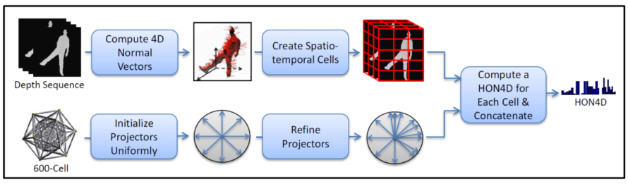
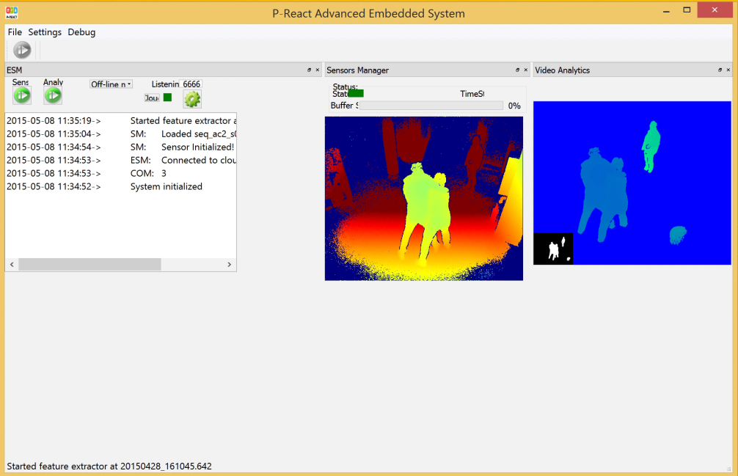
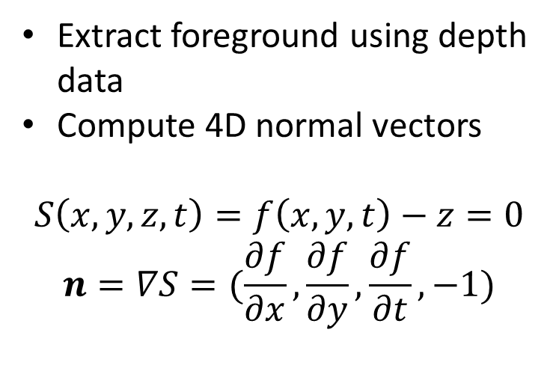
Depth Analytics
Analytics using a depth sensor and a NUC system
Extract foreground using depth data
Compute 4D normal vectors
$$S\left(x,y,z,t\right)=f\left(x,y,t\right)−z=0$$
$$n=∇S=(\frac{∂f}{∂x},\frac{∂f}{∂y},\frac{∂f}{∂t},−1)$$

Slide 8


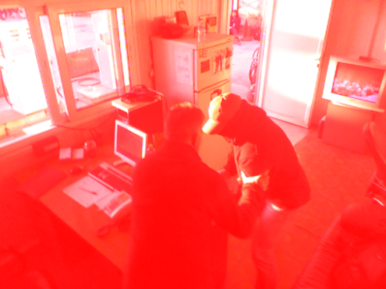
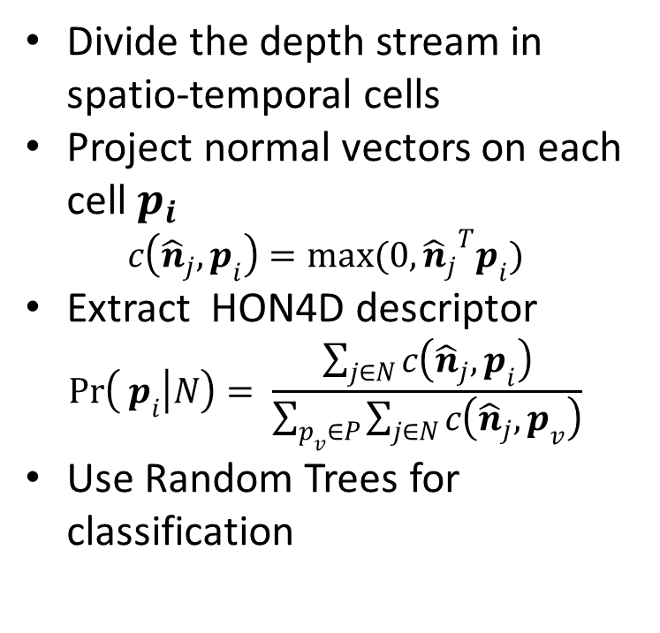
Depth Analytics
Divide the depth stream in spatio-temporal cells
Project normal vectors on each cell $p_{i}$
$$c\left({\hat{n}}_{j}, p_{i}\right)=max(0,{{\hat{n}}_{j}}^{T}p_{i})$$
Extract HON4D descriptor
$$\operatorname{Pr}\left( p_{i} | N\right)= \frac{\sum_{j∈N}{c\left({\hat{n}}_{j}, p_{i}\right)}}{\sum_{p_{v}∈P}{\sum_{j∈N}{c\left({\hat{n}}_{j}, p_{v}\right)}}}$$
Use Random Trees for classification
Accurately detect motion and abnormal incidents (e.g. fighting)

Slide 9
Contact Points
CERTH:
  Dr. Dimitrios Tzovaras, dimitrios.tzovaras@iti.gr
  Mr. Georgios Stavropoulos, stavrop@iti.gr
  Dr. Nikolaos Dimitriou, nikdim@iti.gr
VICOMTECH:
  Mr. Juan Arraiza Irujo, jarraiza@vicomtech.org
  Dr. Marcos Nieto, mnieto@vicomtech.org

