Slide 1

P-REACT
29/03/2016
BOLOGNA TRIAL SCENARIO
&
QUESTIONNAIRE

Slide 2
Scenario
29/03/2016
The trial in Bologna will be conducted within the depot area managed and operated by TPER.
Three Use cases focused on transport sector (outdoor environment)
Graffiti
Fighting
Bag snatching
Economical impact
Italy: FORMAT Research (appointed by Confcommercio, Italian association representing enterprises working for trade, tourism and services providers)
More than 70% of businesses were charged with additional costs to protect themselves against
UK Home Office: The total cost of crime for 2003/04 was £36.2bn
Greece Public Transportation Company: Damages from individuals to railway infrastructure and those from graffiti come up to 5 million Euros per year.
Your feedback is vital for the project to
bridge the gap for a market ready solution

Slide 3
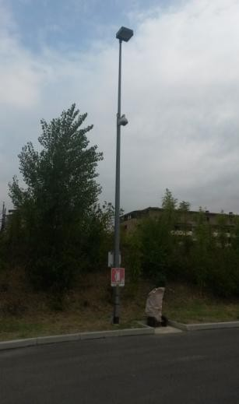
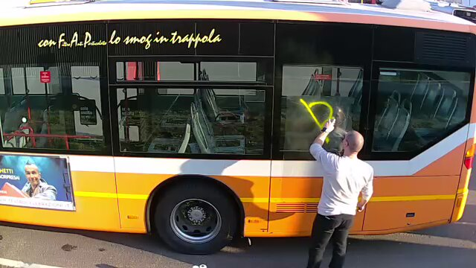
Graffiti Detection
29/03/2016

Slide 4
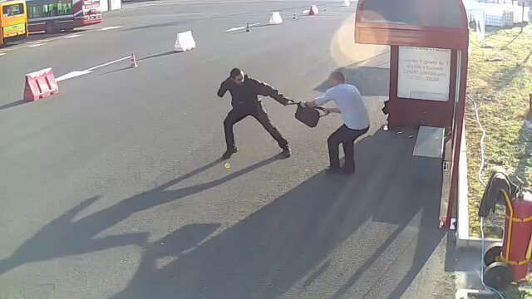

Bag Snatching
29/03/2016

Slide 5
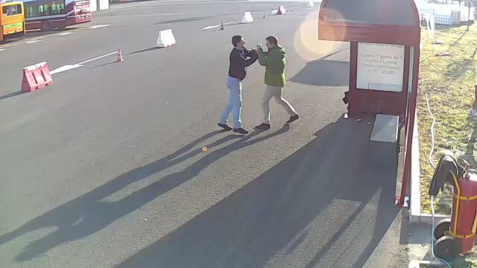
Fighting
29/03/2016

Slide 6
What we are going to see in all 3 use cases is…
29/03/2016
Actors play
Embedded platform
  An event is detected by Video Algorithms
  Video clip is generated
  Video clip is sent to private cloud
Cloud
  Cloud business rules decide if a second level of analysis is required
  Alert is presented to the Operator (in P-REACT GUI)
  P-REACT Operator can: (1) review the video clip, (2) request live view from the camera, (3) inform the proper authority
Video clip is available for further investigation and prosecution

Slide 7
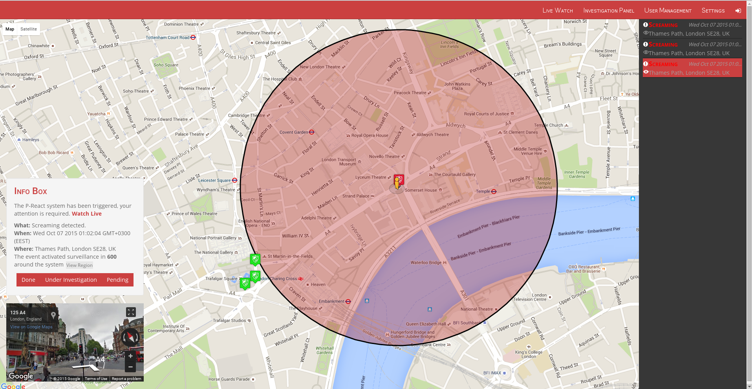
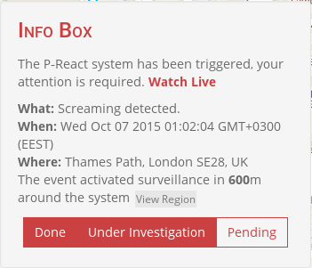
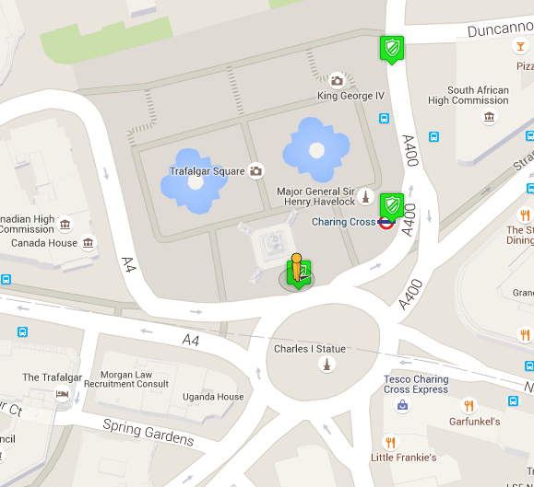
P-REACT Control
29/03/2016

Slide 8
Questionnaire
29/03/2016
Five Parts
Part A: General Information
Part B: P-REACT Framework Validation – Intuitiveness
Part C: P-REACT Product Assessment – Usability
Part D: P-REACT Business Model – Marketability
Part E: Comments

Slide 9
29/03/2016
Thank you for your attention!
More info:
Website: http://p-react.eu/
E-mail: g.kioumourtzis@kemea-research.gr
LinkedIn: www.linkedin.com/groups?gid=8175906

