Slide 1

P-REACT
Project Overview
Project Coordination: Juan Arraiza
E-mail: pc@p-react.eu
Technical Coordination: Mark Sugrue
Email: tc@p-react.eu
Presenter: Dr. Georgios Kioumourtzis
Email: g.kioumourtzis@kemea-research.gr

Slide 2
Table Of Contents
Key message
Introduction to the P-REACT project
Introduction to the P-REACT solution
Main Components
Social, Ethical, Legal, and Privacy aspects
Trials

Slide 3
Key Message
P-REACT is…
  a low-cost surveillance system…
  that combines video, depth, and audio analysis technologies…
  distributed between a local embedded platform (on-site) and a central service (cloud)…
  focused in the prevention and early detection of petty crimes (also known as volume crimes)…
  societal, ethical, legal, and privacy friendly.

Slide 4
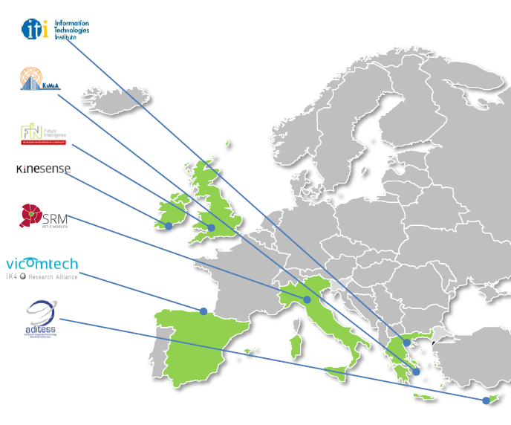

The P-REACT project
Some basic figures and key aspects:
  7 partners from 6 countries
  2 years project (April’14 – March’16)
  1.9 M Euros total budget (1.5 M Euros EU funding)
  11 members in the End-user advisory board

Slide 5
The P-REACT project
Objective 1: To design and develop a cost-effective solution for petty crimes detection, response, investigation and analysis.
Objective 2: To foster collaboration and communication between key users.
Objective 3: Deliver novel video and audio analytics to detect petty crime incidents and develop crime reporting and analysis solutions to strengthen decision-making and responses.
Objective 4: Delivery of novel low cost embedded framework with local intelligence and real-time alert categorization.
Objective 5: To design and develop a novel cloud-based Video Content Management System (VCMS) that is capable of being delivered as service.
Objective 6: To exploit the use of semantic-technologies to aid crime analysis and mapping which will help forecast, prevent and detect future petty crimes.
Objective 7: To analyse technical barriers in the standardisation and scalability of the technologies and to ensure that any societal, ethical and legal issues are properly balanced and addressed.
Objective 8: Demonstration, Validation and Evaluation of the proposed system according to defined user scenarios.

Slide 6
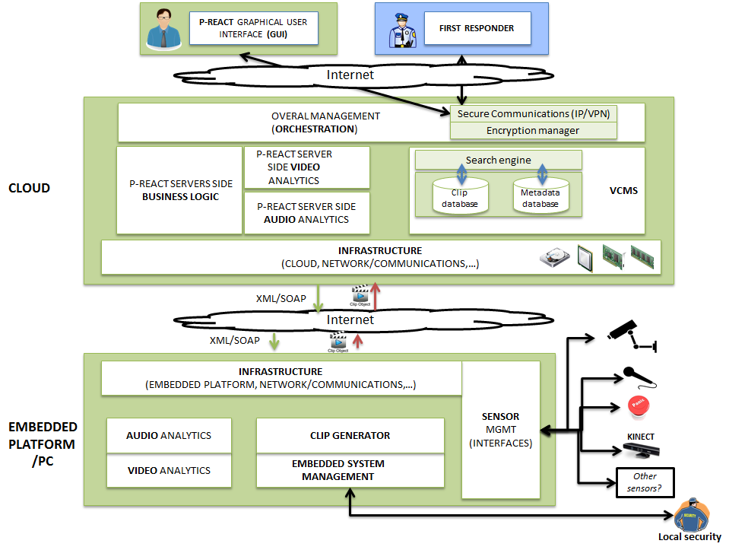
The P-REACT solution

Slide 7

Sensors
Several USB, Network cameras and microphone sensors have been tested and integrated in the Embedded System's operational pipeline.

Slide 8
Embedded System
Embedded System Manager
  Is responsible for effectively coordinating all
  the components of the embedded system
Sensors Manager
  Acquires sensors' data or gets/updates sensors' configuration
Analytics Module
  Perform the appropriate analysis in order to detect petty crimes
  3 Sub-Modules for Video, Depth and Audio analysis
Clip Generator
  Is fired when a petty crime has been detected and gathers the necessary data

Slide 9
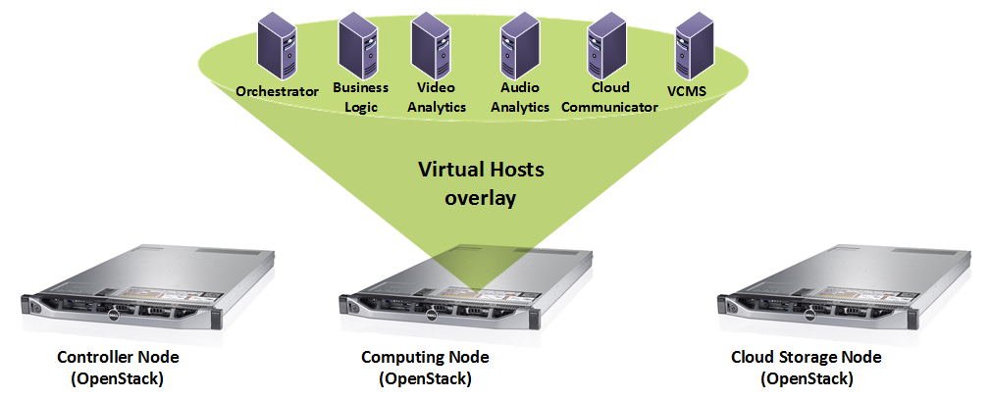
P-REACT Cloud Infrastructure
Open source
Controlled and secured access
Abundance of Computational and Storage resources
Supports private installation for large scale environments

Slide 10
Video Analytics
Types of detected events:
  Fighting
  Chasing
  Bag Snatching
  Intrusion detection
  Graffiti
Real-time processing
Video, Infra-red and Depth cameras are supported
High detection accuracy
Low False-Alarm rates

Slide 11
Audio Analytics
Audio covers a 360-degree area and adds as much to our understanding of events as the captured images
Based on well-established methods from the fields of audio coding, machine learning and speech recognition
Allows efficient operation on low cost power limited devices (or embedded systems)
Manages the detection abnormal events:
Screaming
Gunshots
Glass Breaking
Critical for the seamless triggering of a surveillance system

Slide 12
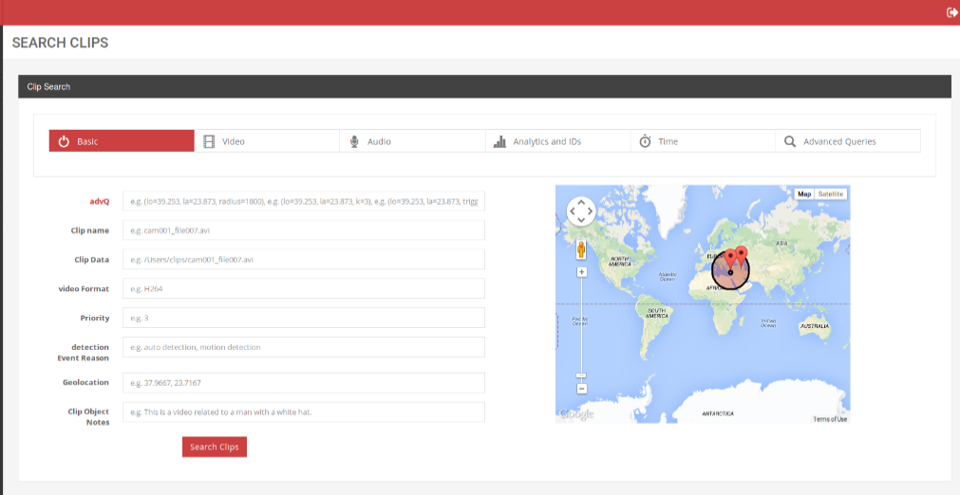
VCMS
The VCMS is a content management system for the efficient management, archiving, fast-indexing, processing of multimedia content through a modular architecture.
Authentication & Security Module
Repository Module
Processing Module
Time tracking metadata are also automatically generated allowing the system to erase content that should not be retained any longer.

Slide 13
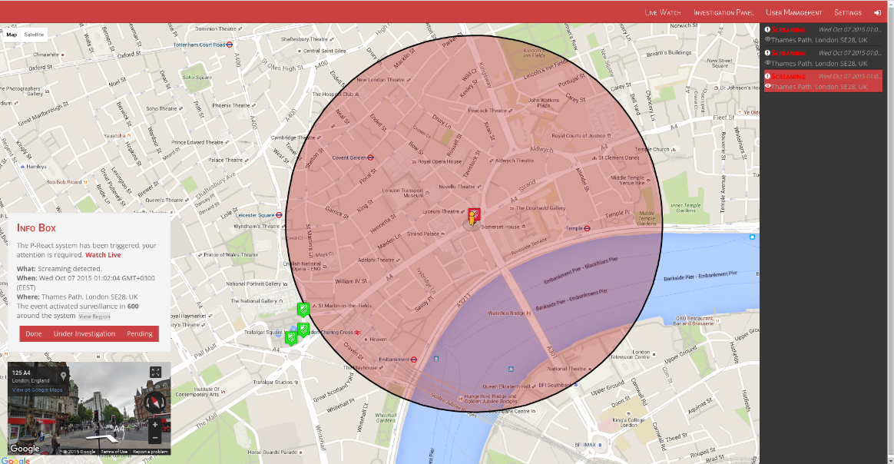
Overall Management
Service Orchestration
Authentication & Security Module
Centralised Intelligence
Graphical User Interface (GUI)

Slide 14
Social, Ethical, Legal & Privacy Issues Management
Analysis of how collected data will be handled based on the applicable legal and regulatory requirements
Identification and address of privacy and ethical concerns within the early stages of platform’s design and development
Adhere to Privacy by Design Approach
Performed a Privacy Impact Assessment (PIA)
  -Validated it’s results by EAB external members
  Definition of Procedures for Protection of Privacy for Informed Voluntary Participants

Slide 15
The trials of the project
Athens Trial, 25 February 2016 (small shop or gas station use case).
Bologna, Italy, 31 March 2016 (transport use case).
Trials will be conducted in controlled areas, real to operational environment, with the participation of external experts.
Best practices and experience from other finished and on-going projects are used.

Slide 16
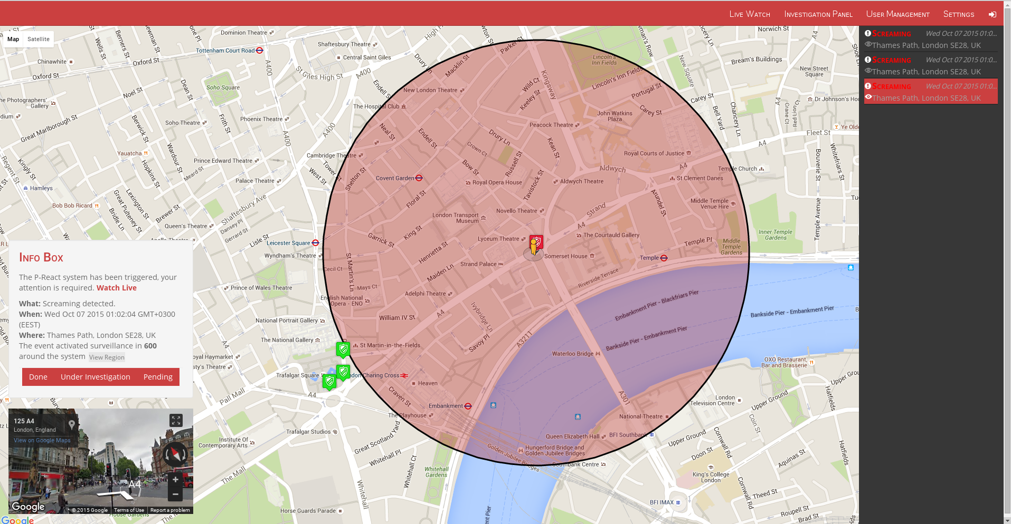
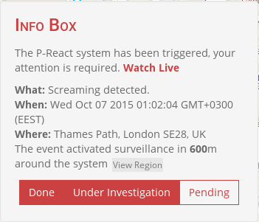
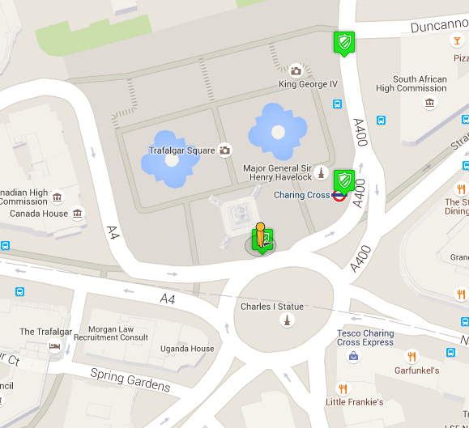
P-REACT Graphical User Interface

Slide 17
Thank you for your attention!
More info at:
Website: http://p-react.eu/
E-mail: contact@p-react.eu
LinkedIn: www.linkedin.com/groups?gid=8175906

