Slide 1

P-REACT
Project Overview
Project Coordination: Juan Arraiza
E-mail: pc@p-react.eu
Technical Coordination: Mark Sugrue
Email: tc@p-react.eu

Slide 2
Table Of Contents
Introduction to the P-REACT project
Key message
Introduction to the P-REACT solution
P-REACT use cases
Social, Ethical, Legal, and Privacy aspects

Slide 3
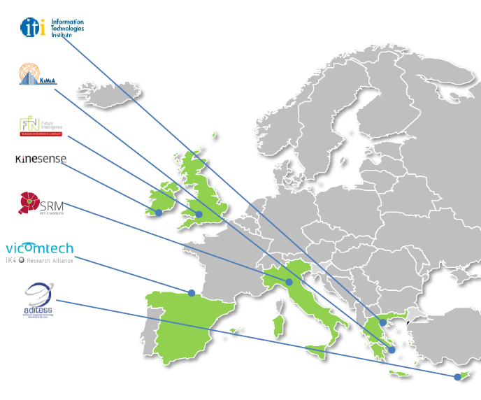
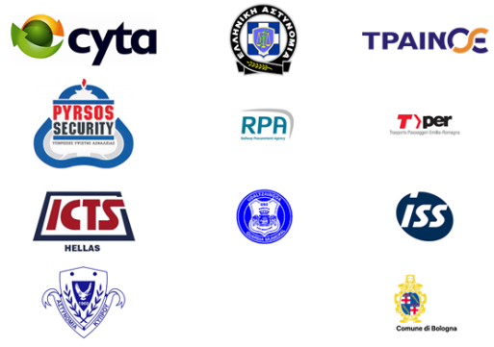
The P-REACT project
Some basic figures and key aspects:
  7 partners from 6 countries
  2 years project (April’14 – March’16)
  1.9 M Euros total budget (1.5 M Euros EU funding)
  11 members in the End-user advisory board

Slide 4
Key Message
P-REACT is… a novel surveillance system… NOT yet another CCTV system
  Interoperable (no vendor lock-in), modular, flexible, scalable, dynamically configurable, low-cost, …
  Distributed between a local embedded platform (on-site) and a central service (cloud)…
  Combines multi-sensor technologies (video, depth, and audio analytics) focused on prevention and early detection of petty crimes (aka volume crimes)
  Advanced prototype (ready to go to market before EOY 2016)
  Societal, ethical, legal, and privacy friendly

Slide 5
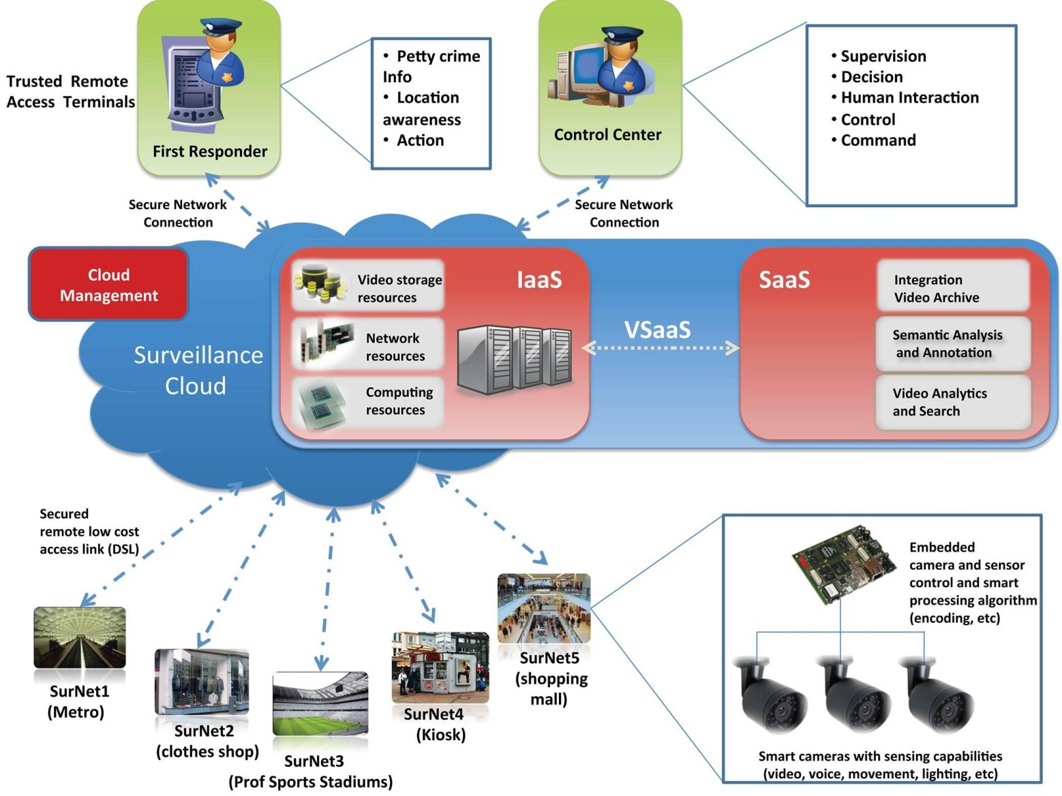
The P-REACT solution

Slide 6
The P-REACT USE CASES
Time and resources were limited so in order to decide which use cases we were going to implement in the P-REACT project we:
Conducted several end-user workshops to identify a list of nineteen use cases
Analysed the technical feasibility
Decided which ones we were going to do
Fighting
Break-in (intrusion)
Assault
Bag Snatching
Chasing
Graffiti

Slide 7
The trials of the project
Two final public trials:
  Athens Trial, 25 February 2016 (small shop or gas station use case). Use cases: assault, break-in (intrusion)
  Bologna, Italy, 31 March 2016 (transport use case). Use cases: graffiti, fighting, bag snatching
Trials will be conducted in controlled areas (real or near to operational environments) with the participation of external experts.
Best practices and experience from other finished and on-going projects are used.

Slide 8
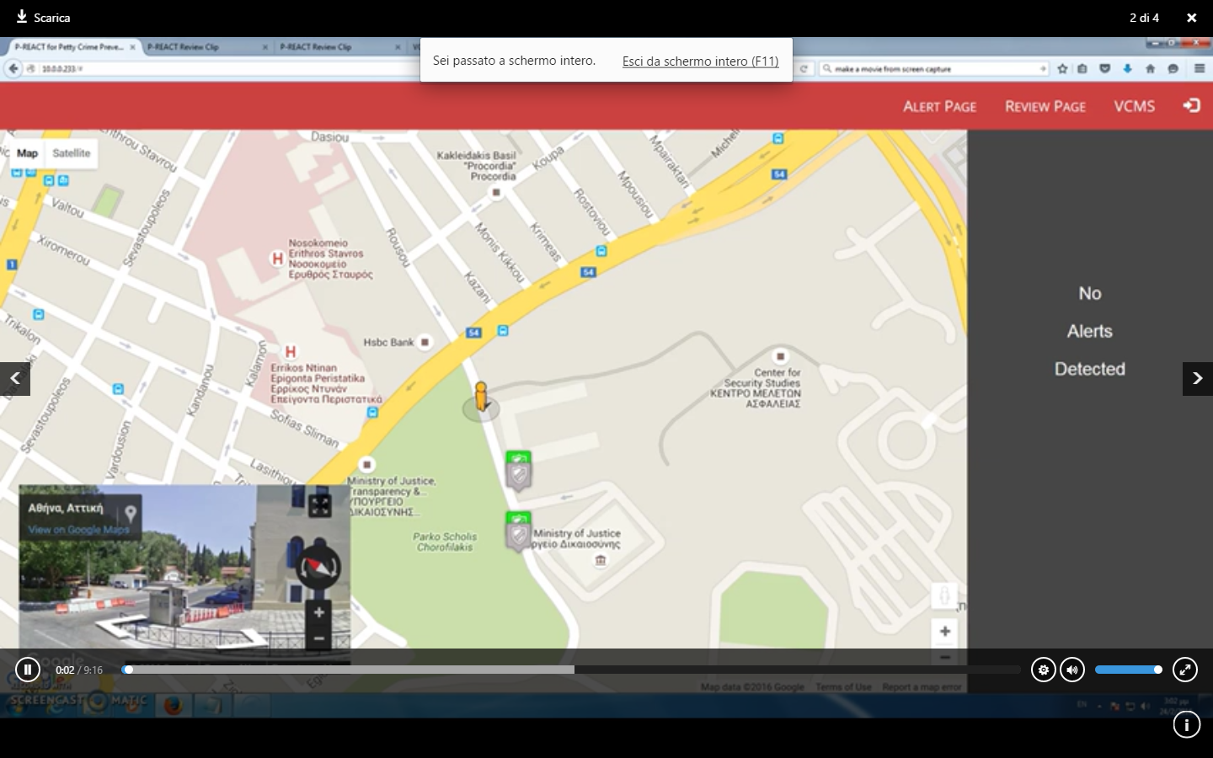
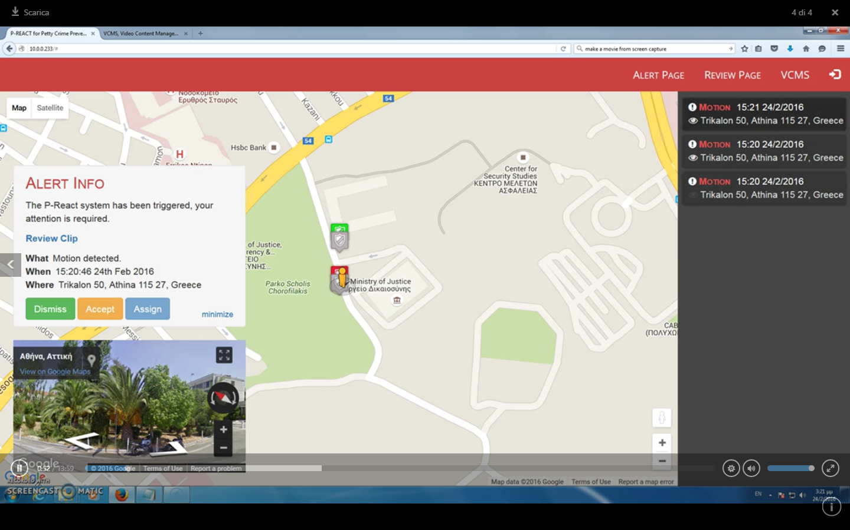
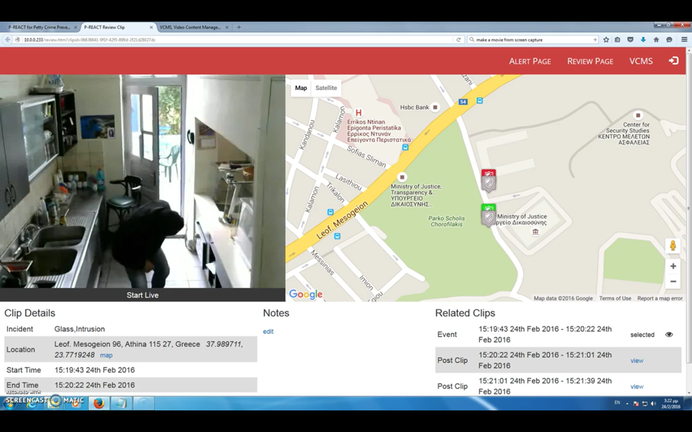
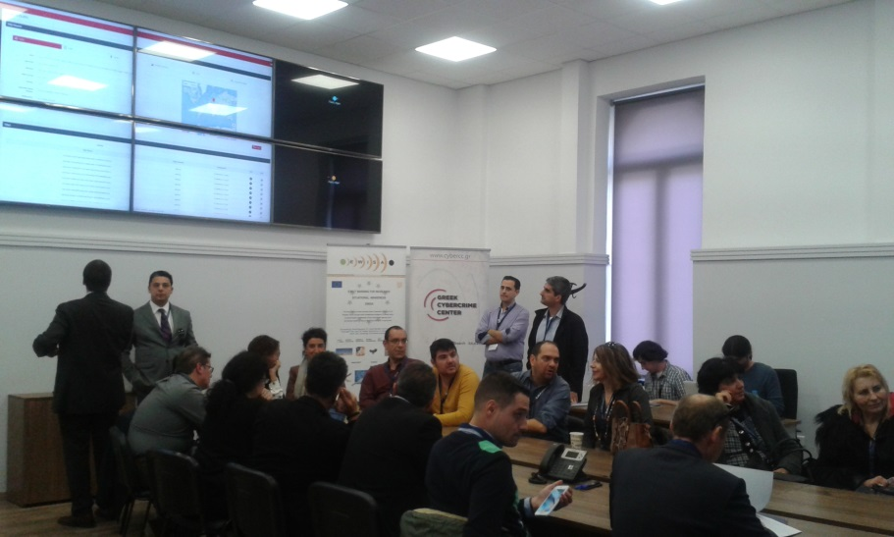
The trials of the project

Slide 9
Social, Ethical, Legal & Privacy Issues Management
Analysis of how collected data will be handled based on the applicable legal and regulatory requirements
Identification and address of privacy and ethical concerns within the early stages of platform’s design and development
Adhere to Privacy by Design Approach
Performed a Privacy Impact Assessment (PIA)
  -Validated it’s results by EAB external members
  Definition of Procedures for Protection of Privacy for Informed Voluntary Participants

Slide 10
Thank you for your attention!
More info at:
Website: p-react.eu
E-mail: contact@p-react.eu
LinkedIn: www.linkedin.com/groups?gid=8175906

